Slide 1
Civil Affairs Capabilities Brief

Slide 2
Agenda
Definitions
Targeting
Network Engagement
Civil Preparation of the Battlespace
Ops in the IE
CA Integration
Concept of Support
Support to the GCE
2025

Slide 3
CA, CAO & CMO
Civil Affairs (CA). Designated Active and Reserve Component forces and units organized, trained, and equipped specifically to conduct civil affairs operations and to support civil-military operations.
Civil Affairs Operations (CAO). Actions planned, coordinated, executed by CA forces, and assessed to enhance awareness of and manage the interaction with the civil component of the operational environment; identify and mitigate underlying causes of instability within civil society; and/or involve the application of functional specialty skills normally the responsibility of civil government.
Civil-Military Operations (CMO). Activities of a commander performed by designated military forces that establish, maintain, influence, or exploit relations between military forces, indigenous populations, and institutions, by directly supporting the achievement of objectives relating to the reestablishment or maintenance of stability within a region or host nation.

Slide 4
Targeting the Population
Country Name
Population: 11.5 million
City Name
Population: 1 million
Future Operating Environment
Dense population centers
Mass migrations
Notes:
It’s not about soccer balls – it’s about effectively targeting the population
MCIA Future Operating Environment

Slide 5
Risks
Prolonged presence
Destabilization by improper targeting
Mission failure
Legitimize malign actors
Lose support of the HN populace
Loss of message credibility
Improper MOEs
Notes:
There are real world risks to not effectively focusing on local populations. The variables of XXX MILLION people need to be accounted for.

Slide 6
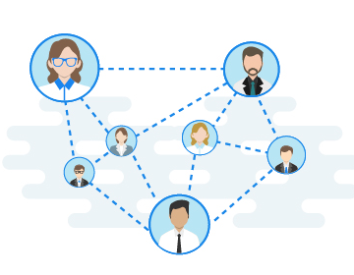
Network Engagement
It’s a people business
Engagements
Assessments
Access
Every network can be traced to a person
Sources of Stability/Instability
Spoilers/Bad Actors
Notes:
Networks are not just systems and computers
At the end of the day it’s a people business, and there’s a human network and a human behind every computer
CA Forces conduct engagements with the local population and assess buildings and infrastructure within the AO.
CA gains access to locations/individuals that don’t normally interact with the military
CA can find and determine sources of stability and instability and create activities to mitigate or isolate spoilers/bad actors/sources of instability

Slide 7
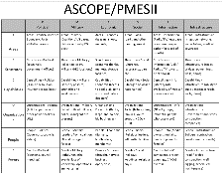
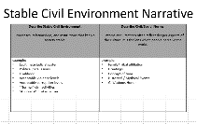
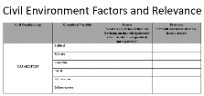
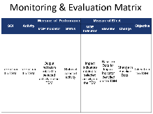
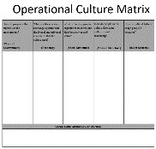
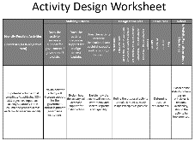
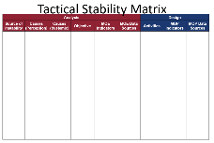
Civil Preparation of the Battlespace
Civil Considerations – Areas Structures Capabilities Organizations People Events
Operational Variables – Political Military Economic Social Infrastructure Information
Civil Environment Factors and Relevance
Key Influences – Motivations/Goals, Impact
Operational Culture – Impacts on MAGTF Operations
Stability and Instability Factors – Grievances, Resiliencies
Stable Civil Environment Narrative
Notes:
CPB is a product based CA process for a more in depth look at civil considerations

Slide 8
CPB – IPB - MCPP
C P B
I P B
Problem Framing
COA Development
COA War Game
COA Comparison & Decision
Orders Development
Transition
Design
Notes:
CPB can be a stand alone process but also fits into the overall IPB

Slide 9
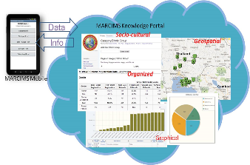
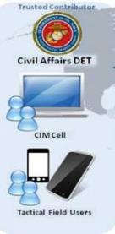
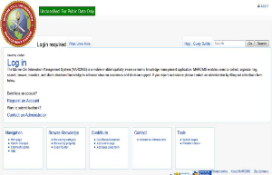
MARCIMS
MARCIMS Mobile (hand-held device)
Collect data in the field
Can be used in a disconnected environment
Not exclusive
MARCIMS Portal (web- based)
Semantic Wiki knowledge base portal
Collect via forms
Create queries
Build pages
Notes:
-MARCIMS consists of two major components;
MARCIMS Mobile is a mobile application (hosted on Mobile Device) for data collection by users in the field
MARCIMS Portal is a semantic wiki knowledge base, for automated information structuring and knowledge management.
Reminder, **It is important to remember that Collection is not exclusive to the mobile app and can be done on the Portal as well. Within the Portal, users create queries and build pages to visualize queries to share information.
REMEMBER* MARCIMS is a repository of information.

Slide 10
CA Integration Matrix
CMO/CA Task:
IRC | Desired Action(s) from IRC
MISO
PA
COMCAM
Intel
EW
Interagency
Phys Sec
Cyber
Notes:
This is not a tasking matrix nor does it indicate that IRCs are supporting CA/CMO
An engagement is not an engagement and shouldn’t be done in isolation.
Other IRCs may want to take advantage of CA tasks
This should be done at either the CMO or IO Working Group

Slide 11
CA Integration Matrix
CMO/CA Task: Establish CMOC IVO Objective 1
CMO/CA Desired Effect or sub-tasks: Solatia, battle damage claims, engage with LNs/NGOs etc
IRC | Desired Action(s) from IRC
MISO | Inform via engagements and/or loudspeakers the location of CMOC and what civilians can do there, message pro US and HN support to population
PA | Inform via media contacts the location of CMOC and what typically occurs there, message pro US and HN support to population
COMCAM | Document CMOC operations and engagements
Intel | Provide identity operations support by providing biometric collection tools, conduct analysis post engagement
EW | Signature collection IVO CMOC
Interagency | Provide LNOs to support CMOC operations
Phys Sec | Ensure physical security measure are implemented for information networks at CMOC
Cyber | Establish, operate, and defend a network that delivers effective CMO and C2
Notes:
Advise
To improve the individual and unit capabilities and capacities of host nation security forces through the development of personal and professional relationships between United States and host nation forces.
Assess the Population
To evaluate the nature, situation, and attitudes of a designated population or elements of a population, inhabiting the area of operations.
Assist
To provide designated support or sustainment capabilities to host nation security forces to enable them to accomplish their objectives.
Build/Restore Infrastructure
To construct, rebuild, or repair local infrastructure to support the host nation and gain or maintain the cooperation of the local population.
Contain
To prevent or halt elements of a population or designated party from departing or projecting physical influence beyond a defined area. See also enemy-oriented tactical tasks.
Control
To use physical control measures and information-related capabilities to influence elements of a population or designated actors to respond as desired. See also terrain-oriented tactical tasks.
Coordinate With Civil Authorities
To interact with, maintain communication, and harmonize friendly military activities with those of other interorganizational agencies and coalition partners to achieve unity of effort.
Cordon
To temporarily prevent movement to or from a prescribed area such as a neighborhood, city block, series of buildings, or other feature. See also terrain-oriented tactical tasks.
Enable Civil Authorities
To support or assist the host nation government and designated interorganizational agencies in providing effective governance.
Exclude
To prevent or halt elements of a population or designated party from entering or projecting physical influence into a defined area.
Influence
To persuade the local population, including potential and known adversaries, within the operational area to support, cooperate with, or at least accept the friendly force presence, and dissuade the local population from interfering with operations.See also enemy-oriented tactical tasks.
Reconnoiter
To obtain, by visual observation or other methods, information about civil considerations. See also enemy- and terrain-oriented tactical tasks.
Secure
To gain possession of a position, terrain feature, piece of infrastructure, or civil asset, with or without force, and prevent its destruction or loss by enemy action. See also terrain-oriented tactical tasks.
Train
To teach designated skills or behaviors to improve the individual and unit capabilities and capacities of host nation security forces.

Slide 12
Concept of Support
CA Element | MOS Breakdown | Supports
CA Team | 1x 0535 O4 1x 0530 O3 1x 0539 E6 1x 0531/2 E5 1x 0531/2 E4 | Infantry Battalion MEU
CA Detachment | 1x 0535 O5 1x 0539 E7 2x 0535 O4 3x CA Team | Infantry Regiment
G9 Branch | 1x 0535 O5 2x 0535 O4 2x 0530 O4 2x 0530 O3 2x 0539 E7 2x 0532 E6 1x 0532 E5 | MEB/MEF
CA Group | 1x 0535 O6 (CO, AC/S G9) 1x 0535 O5 (XO) 1x 0535 O5 (OpsO) 1x 0539 E8 (Ops Chief) 1x G9 Branch 4x CA Detachment | MEB/MEF

Slide 13
CA Activities
Shape
Deter
Seize Initiative
Dominate
Stabilize
Enable Civil Authorities
-Civil Preparation of the Battlespace
-Civil Recon: assessments and key leader engagements
-Influence through engagements and coordination with MISO/COMMSTRAT and messaging
-Civil Information Management
-Assist IOs, NGOs, USG agencies, Host Nation
-Provide information on individuals in within a network, systems, or sources of instability the MAGTF is targeting.
-Coordinate with Strategic Communications and local authorities to influence to inform domestic and international audiences.
-Establish MOEs and MOPs that aid in determining progress.
-Minimize civilian interference
-Provide input into IOWG and B2C2WGs
-Influence target audiences through engagements and coordination with MISO and messaging strategies.
-Establish CMOC
-Establish coordination measures for stability via local leaders to eliminate casualties and damage to property.
-Increase engagements and relationships with identified key leaders
-Identify deliberate assessments and recommend projects
 | Goals | Desired Outcome
Shape | Gain access, increase influence | Dissuade potential adversaries, assure relationships with allies.
Deter | Deter adversary action | Demonstrate force capabilities
Seize | Est stability conditions | Refine transition planning
Dominate | Breaking enemy will for resistance | Refine stability and transition planning
Stabilize | Prioritize stability tasks | Est/restore civil security
Enable | Support civil governance | Return to shaping operations
-Dissemination Platform: host nation projects, messaging, civic action programs.
-Rendering the enemy irrelevant. Denying adversaries the ability to influence the population.
-Assess measures of effectiveness and performance.
-Provide negotiation and mediation capabilities to host nation organizations.

Slide 14
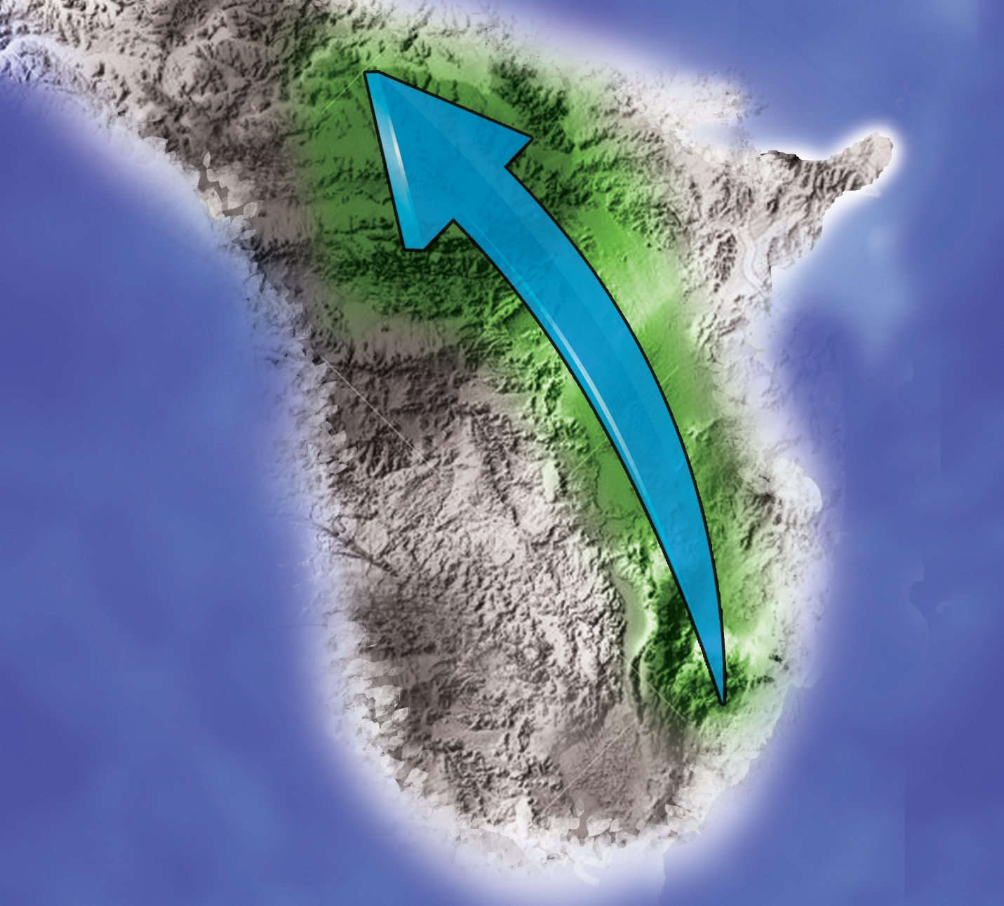
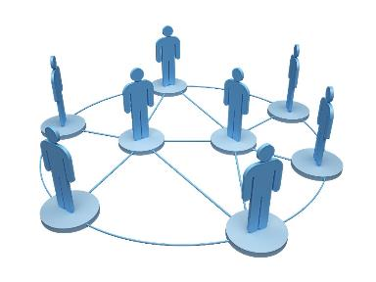
Support to GCE
CA
TM
CA
TM
CA
TM
VMM
l l l
CA
Det
Notes:
It’s all about supporting the commander
Provide civil considerations until he/she makes a decision then support it with CA activities
If the CO wants to go through a dense population center give him the civil considerations and maybe it might be best to go around and not through
If time and mission have priority and you have to go through the dense population center then provide ways to mitigate negative effects. Capture battle damage for claims/solatia payments. Follow en-trace and establish a CMOC, provide MEDCAPs, engage with local leaders to assess key infrastructure or anything else that may have been damaged. All of this is to influence and gain back support.

Slide 15
CA Forces
Pre-2025
1 CA Detachment at Each MEF (51 billets per)
Planners at MEUs and Regiments (70 billets)
4 CAGs
Current
Planners at MEUs and Regiments (70 billets)
4 CAGs
Post Reserve 2025
Redistribute 70 AC Billets
4 CAGs?
Female Engagement FMOS 0534/0538

Slide 16
CA Training
0530 CA Officer
0531 Civil Reconnaissance NCO
0532 CA Specialist (PMOS)
0535 CMO Planner
0539 CMO Planner Chief
0534 Female Engagement Officer
0538 Female Engagement Specialist
*FY19
4 Weeks
2 Weeks
Career Progression
0530/1/2
+
JKO Course (J3TA-MN1292) Improving operational
effectiveness by integrating gender perspective.

Slide 17
Questions?

