Slide 1
INTRODUCTION TO THE
SERVICE RIFLE AND MAINTENANCE

Slide 2
OVERVIEW
DISASSEMBLY
MAINTENANCE
ASSEMBLY

Slide 3
TERMINAL LEARNING OBJECTIVE
Given a service rifle, Common Combat Sling, and cleaning gear maintain a service rifle to ensure the weapon is complete clean and serviceable.

Slide 4
Learning Objectives
Given a service rifle, Common Combat Sling, and cleaning gear maintain a service rifle to ensure the weapon is complete clean and serviceable, disassemble the weapon.
Given a service rifle, Common Combat Sling, and cleaning gear maintain a service rifle to ensure the weapon is complete clean and serviceable, perform maintenance of the weapon.
Given a service rifle, Common Combat Sling, and cleaning gear maintain a service rifle to ensure the weapon is complete clean and serviceable, assemble the weapon.

Slide 5
Method/Media
Evaluation
Safety/Cease Training
Administrative Notes

Slide 6
?
What I will
Be
Teaching???
How I will
Be
Teaching???
How You will
Be
Evaluated???

Slide 7
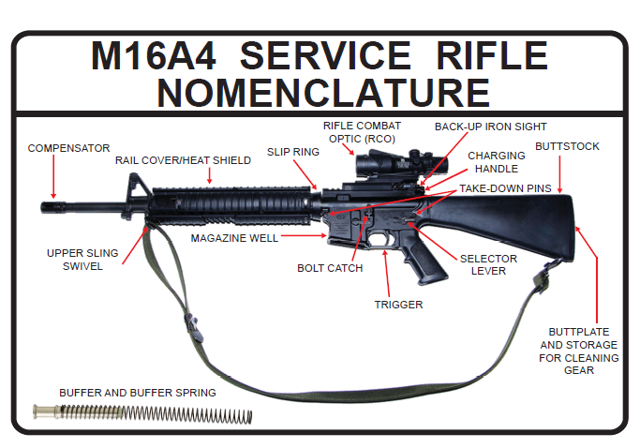
M16A4 SERVICE RIFLE NOMENCLATURE

Slide 9
CLEARING THE SERVICE RIFLE
Clearing the service rifle means to ensure that
the rifle is free of ammunition. To clear the
service rifle:
Attempt to move the selector lever to the SAFE position.
Depress the magazine release button and remove the
magazine.
Pull the charging handle to the rear and lock the bolt.
Ensure the chamber is empty; Let the bolt go forward
and observe the bolt moving forward in an empty
chamber. Close the ejection port cover.

Slide 10
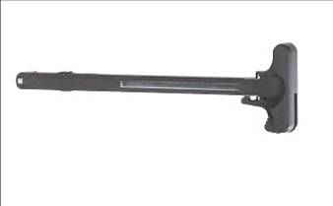
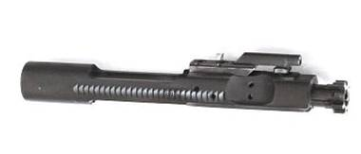
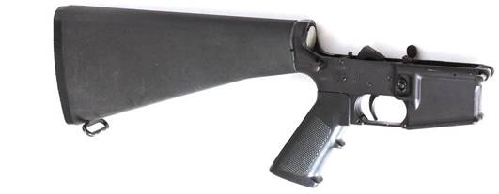
DISASSEMBLE THE SERVICE RIFLE
The Disassembly of the Service Rifle into Three
Main Groups:
Upper Receiver
Bolt Carrier Group
Lower Receiver

Slide 11
DETAILED DISASSEMBLY
Detailed Disassembly of the Service Rifle:
UPPER RECEIVER

Slide 12
DETAILED DISASSEMBLY
Detailed Disassembly of the Service Rifle:
BOLT CARRIER GROUP

Slide 13
DETAILED DISASSEMBLY
Detailed Disassembly of the Service Rifle:
LOWER RECEIVER

Slide 14
CLEANING THE SERVICE RIFLE
NORMAL CARE AND CLEANING: Normal care and cleaning will
result in proper functioning of all parts of the rifle.
Use only authorized cleaning materials because using non
authorized cleaning materials can result in stoppages, or even
breakage.
INSPECTION: While cleaning the rifle, and during each succeeding
step in the preventive maintenance process, inspect each part for
cracks and chips and to ensure parts are not bent or badly worn.
Report any damaged part to the armorer.
An inspection is normally performed during rifle cleaning (prior to
lubrication), however, it can be performed throughout the
preventive maintenance process.

Slide 15
CLEANING THE SERVICE RIFLE
UPPER RECEIVER: Basic cleaning should include:
Point the muzzle down and insert the non-patch end of the
rod into the chamber. Attach the handle to the cleaning rod
section and pull a CLP-moistened patch through the bore.
Put a few drops of CLP on the bore brush. Insert the rod
into the barrel from the chamber end, and pull the brush
through the bore. Inspect the bore for cleanliness.
Clean the interior portion of the upper receiver with the
general purpose brush and CLP.
Wipe the barrel, gas tube, and rail cover/heat shields clean
with a rag.

Slide 16
CLEANING THE SERVICE RIFLE
BOLT CARRIER GROUP: Basic cleaning should include:
Clean the outer and inner surfaces of the bolt carrier with a general
purpose brush; Clean the bolt carrier key with a pipe cleaner.
Insert a swab into the rear of the bolt and swab out the firing pin recess
and gas ports.
Clean the extractor with the general purpose brush, ensuring all the
carbon is removed from underneath the extractor lip.
Clean the firing pin, firing pin retaining pin, and extractor pin using the
general purpose brush and CLP.
Clean the charging handle assembly with the general purpose brush and
patches.

Slide 17
CLEANING THE SERVICE RIFLE
LOWER RECEIVER: Basic cleaning should include:
Wipe dirt from the firing mechanism with a clean patch and
general purpose brush/pipe cleaners.
Clean the outside of the receiver with the general purpose
brush and CLP. Clean the butt plate and rear sling swivel,
ensuring the drain hole is clear of dirt.
Wipe the inside of the buffer tube, buffer, and action spring.
Wipe the inside of the magazine well with a rag.
Wipe out the inside of the pistol grip, ensuring it is clean.

Slide 18
CLEANING THE SERVICE RIFLE
RIFLE COMBAT OPTIC (RCO): Basic cleaning should include:
Remove sand or dirt from the lenses. Take care not to
scratch the lens.
Gently apply felt cleaner to lenses to achieve cleanliness.
Protect the RCO with the cover when not in use.
MAGAZINE: Basic cleaning should include:
Clean the inside of the magazine with the general purpose
brush and CLP; Wipe dry.
Keep the spring lightly oiled.

Slide 19
CLEANING THE SERVICE RIFLE
The climatic conditions in various locations require
special knowledge about cleaning and maintaining
the service rifle. The abnormal weather conditions
that will affect the service rifle the most are:
HOT, WET TROPICAL
HOT, DRY DESERT
ARCTIC OR LOW TEMPERATURE
HEAVY RAIN

Slide 20
LUBRICATING THE SERVICE RIFLE
Lubrication is performed as part of the detailed
procedure for preventive maintenance:
In all but the coldest arctic conditions, CLP is the
lubricant for the service rifle. Remember to remove
excess CLP from the bore and chamber before firing.
Lightly lube means that a film of CLP barely visible to
the eye should be applied.
Generously lube means that the CLP should be applied
heavily enough that it can be spread with the finger.

Slide 21
REASSEMBLE THE SERVICE RIFLE
Re-Assembly of the Service Rifle:
LOWER RECEIVER
BOLT CARRIER GROUP
UPPER RECEIVER
MAGAZINE

Slide 22
PERFORM A FUNCTION CHECK
Ensure the service rifle is in Condition 4.
Pull charging handle to the rear and release. Ensure selector level is
on SAFE. Move the trigger to the rear – hammer should not fall.
Place selector lever on SEMI. Move the trigger to the rear and hold to
the rear – hammer should fall. While holding the trigger to the rear,
pull charging handle to the rear and release. Release trigger until you
hear a “clunk.”
Place selector lever on BURST. Move the trigger to the rear and hold
to the rear – hammer should fall. While holding the trigger to the
rear, pull charging handle to the rear three times and release. Release
trigger until you hear a “clunk, and move to the rear again – hammer
should fall.”
Pull charging handle to the rear and release. Place selector lever on
SAFE; close ejection port cover.

Slide 23
USER’S SERVICABILITY INSPECTION
Check the service rifle to ensure the following:
The service rifle is in Condition 4.
The compensator is centered and tight.
The barrel is tight.
The hand guards are serviceable.
Sighting System: RCO is attached correctly/throw levers secures,
lenses not cracked, scratched, or broken. The fiber optic cable is
serviceable. The RCO is securely mounted to the rail system.
Stock: Tight on lower receiver, then break weapon down “shotgun
style.” The buffer tube is straight and not cracked. The sling keeper
can be adjusted and secured.

Slide 24
USER’S SERVICABILITY INSPECTION
Chamber/Barrel: Clear of obstructions, no major pitts or cracks.
Gas Tube (from chamber end): Not bent or damaged, is securely fixed.
Bolt Carrier Group: Properly assembled, rotates freely, and gas rings
are staggered evenly around the bolt.
Lubrication: Lubricated for operational conditions and climate.
The pistol grip is tight.
The trigger guard release pin is locked into place.
The ejection port operates correctly.
Load the rifle with an empty magazine. Pull the charging handle to the
rear. Ensure that the bolt locks to the rear.

Slide 25
QUESTIONS?

Slide 26
SUMMARY
DISASSEMBLY
MAINTENANCE
ASSEMBLY

