Slide 1
Scantron Directions
Write your last name, first name, middle initial, company and platoon AND name of the class
Fill in the last nine digits of your EDIPI as the identification number
Number two pencils only

Slide 2
Quiz Directions
This is a weighted evaluation
Do NOT use any reference material
Do NOT talk to other students
Number two pencils only
You may not leave the classroom
There are 10 multiple choice questions
You will have 10 minutes
Standby…
Notes:
Clear your desks!

Slide 3
Question #1
(TBS-COMM-2101k) You are required to speak to higher. They are located 8.5 Km away. What configuration of communications equipment should you use?
AN/PRC-117F; HI PWR; SINCGARS; 10Ft Whip
AN/PRC-117F; LO PWR; VHF; 3ft Blade
C. AN/PRC-152, HI PWR; HF; SATCOM WAVEFORM; Spider Antenna

Slide 4
Question #2
(TBS-COMM-2101l) Friendly forces are 500 miles away. You need a form of long haul communication to speak to them?
VHF
UHF
EHF
HF

Slide 5
Question #3
(TBS-COMM-2101l) SINCGARS uses which frequency band?
VHF
B. HF
C. UHF
D. Rubber

Slide 6
Question #4
(TBS-COMM-2101l) What is the planning range for an AN/PRC-117F in SINCGARS Mode?
28,000 Miles
10 Km
1000Km
Indefinite

Slide 7
Question #5
(TBS-COMM-2101j) T or F: AN/PRC-152 is ideal for Intra-Squad communication due to its small size, portability, and limited power output?
True
False

Slide 8
Times Up
Pencils down
Pass scantrons to the left
Pass scantrons to the front
All scantrons should be facing the same way

Slide 9
Quiz Review

Slide 10
Question #1
(TBS-COMM-2101k) You are required to speak to higher. They are located 8.5 Km away. What configuration of communications equipment should you use?
AN/PRC-117F; HI PWR; SINCGARS; 10Ft Whip
AN/PRC-117F; LO PWR; VHF; 3ft Blade
C. AN/PRC-152, HI PWR; HF; SATCOM WAVEFORM; Spider Antenna

Slide 11
Question #2
(TBS-COMM-2101l) Friendly forces are 500 miles away. You need a form of long haul communication to speak to them.?
VHF
UHF
EHF
HF

Slide 12
Question #3
(TBS-COMM-2101l) SINCGARS uses which frequency band?
VHF
B. HF
C. UHF
D. Rubber

Slide 13
Question #4
(TBS-COMM-2101l) What is the planning range for an AN/PRC-117F in SINCGARS Mode?
28,000 Miles
10 Km
1000Km
Indefinite

Slide 14
Question #5
(TBS-COMM-2101j) T or F: AN/PRC-152 is ideal for Intra-Squad communication due to its small size, portability, and limited power output?
True
False

Slide 15
Communications Equipment II
Captain Lawrance P. Andrus
lawrance.andrus@usmc.mil
(703) 432-6363
B280385 XQ

Slide 16
Overview
PRC-152 and PRC-150 Multiband Radio
High Frequency Band (HF) (p.14)
Very High Frequency Band (VHF) (p. 14)
Ultra-High Frequency Band (UHF) (p. 15)
MAGTF Communications System Equipment (PRC-117F) (p. 23-28)
Practical Application Exercise
Notes:
Overview and Agenda of platform class.
Emphasize that this is only the tip of the iceberg. TBS is the “The BASIC School” so they will not be getting the most high-speed gear out there. The basics of Command & Control and of radio procedures. Will only be scratching the very surface of tactical communications in the MC.
Big ticket item is not to get wrapped around the axle of the scientific and physics principles of comm.

Slide 17
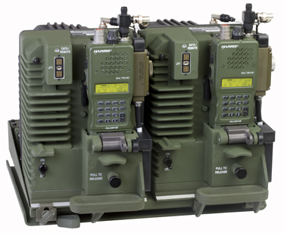
PRC-152F: Multiband Radio
Radio that is capable of operating in more than one frequency band. i.e VHF, UHF.
Notes:
The RT-1523 is the base model RT for all SINCGARS radios. Explain to them that without the SL-3 gear that we will cover later it does nothing for us.

Slide 18
RT-1916 (PRC-152)
Radio/Spec | RT | Freq Range | Op Mode | Pwr Out | Pl Range
PRC-152 | RT-1916 | 30-512 MHz | VHF, UHF LOS, DED SATCOM, DAMA | 5W | 5-8KM
VRC-110 | 2x RT-1916 | 30-512 MHz | VHF, UHF LOS, DED SATCOM, DAMA | 20-50W | 20-50KM
Harris FALCON III
PRC-152
Heavily employed at the platoon and squad level for VHF, UHF, and SatCom
Recommended use for intra-squad communications
VRC-110
Same capability in a (dual) vehicle mounted, amplified package
Notes:
Talk capabilities and limitations.
Introduce big picture employment. Distributed Operations.

Slide 19
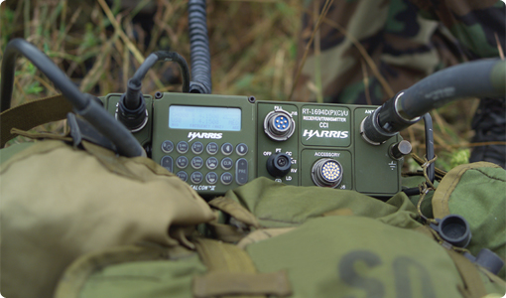
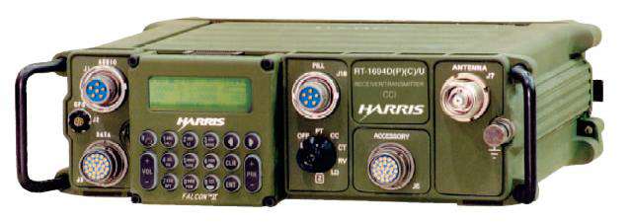
PRC-150: Multiband Radio
Radio that is capable of operating in more than one frequency band. i.e VHF, HF.
Notes:
The RT-1523 is the base model RT for all SINCGARS radios. Explain to them that without the SL-3 gear that we will cover later it does nothing for us.

Slide 20
High Frequency (HF)
Long haul communications
Lower HF frequencies can communicate over a greater distance
Frequency Range: 1.6 - 29.99 MHz

Slide 21
RT-1694 (AN/PRC-150)
Radio/Spec | RT | Freq Range | Modulation Types | Power Output | Planning Ranges(HF)
PRC-150 | RT-1694 | 1.6-60 MHz | USB,LSB,CW,AM,FM | 1, 5, 20W-HF 1, 5, 10W-VHF | 15 km Ground Wave
Typically employed at the team and company level to extend voice/data communication beyond Line of Site
Capable of talking thousands of Km’s when utilizing sky wave transmission (other factors apply)
Requires x2 BA-5590 (or equivalent) for power
Typically construct field expedient antennas for long distance transmissions.

Slide 22
Decision Forcing Exercise
Task Organization
Tactical Situation
Task Organization
-1stBn, 5th Mar
-C Co
-1st Platoon
-2nd Platoon
-3rd Platoon
-FAC
-81mm FO
-CAAT Plt (DS)
-SSP Plt (DS)
-81s Plt (DS)
-MAG-39
FRIENDLY SITUATION: You were recently promoted to Company XO. You are the executive officer for Charlie Company, 1st Battalion, 5th Marines. Your Company is currently prepared to conduct Operation Hoplite Fury. Your Company’s subordinate units are currently in their respective assembly areas conducting local security patrols. MAG-39 is providing air support.
ENEMY SITUATION: The enemy consists of an Infantry Company and a Light Armor Platoon supported by an Artillery Battery. They are currently in defensive positions.
HIGHER MISSION: O/O, 1st Battalion, 5th Marines clears in zone in order to set conditions for 5th Marines’ advance.
MISSION: NLT 1500, Charlie Company clears BN OBJ A in order to allow advance of 1st Battalion, 5th Marines.

Slide 23
Decision Forcing Exercise
Use Comm Equip 1/2 (P.14-15;23-26) and Comm Equipment Prac App I/II (p.7;16-17;28)
1. Given the Tactical Situation and Task Organization, what radio nets would you establish and why? What units need to be on which nets? Include air nets and higher’s nets that you wouldn’t be responsible for establishing. Keep your subordinate units’ likely missions and capabilities in mind. You are not confined to the matrix
Net | Spectrum | Units on net | Reason
BN TAC 1 | VHF FH | BN COC, all companies, all DS plts | To allow BN CO to C2 his subord. units

Slide 24
Decision Forcing Exercise
Use Comm Equip 1/2 (P.14-15;23-26) and Comm Equipment Prac App I/II (p.7;16-17;28)
2. What equipment will you need to complete your plan? You must provide gear to all of your units, to include BN COCs, companies, and DS platoons. Include radios by type, non-SL-3 antennas, and any required auxiliary equipment. Break allocation down by unit. You are not confined to the matrix.
Unit/Asset | VRC110 | MRC148 | PRC-117 | PRC-152 | DAGR | 2590’s | DTD
C CO
1st Plt
2nd Plt
3rd Plt
CAAT PLT
SSP PLT
81S PLT

Slide 25
Decision Forcing Exercise
Use Comm Equip 1/2 (P.14-15;23-26) and Comm Equipment Prac App I/II (p.7;16-17;28)
Given the Tactical Situation, Task Organization, and your answer from question 1, what is the number of frequencies and Net IDS required to support ALL of the company’s nets? Answer by spectrum. (See Annex J)

Slide 26
Review
PRC-152 and PRC-150 Multiband Radio
High Frequency Band (HF) (p.14)
Very High Frequency Band (VHF) (p. 14)
Ultra-High Frequency Band (UHF) (p. 15)
MAGTF Communications System
Equipment
PRC-150 (p. 23)
PRC-152 (p. 25-26)
Practical Application Exercise
Notes:
Overview and Agenda of platform class.
Emphasize that this is only the tip of the iceberg. TBS is the “The BASIC School” so they will not be getting the most high-speed gear out there. The basics of Command & Control and of radio procedures. Will only be scratching the very surface of tactical communications in the MC.
Big ticket item is not to get wrapped around the axle of the scientific and physics principles of comm.

Slide 27
Questions?
Captain Andrus
lawrance.andrus@usmc.mil

Slide 28
Communications Equipment II
“Confronted with a task, and having less information available than is needed to perform that task, an organization may react in either of two ways. One is to increase its information processing capacity, the other to design the organization, and indeed the task itself, in such a way as to enable it to operate on the basis of less information. These approaches are exhaustive; no others are conceivable. A failure to adopt one or the other will automatically result in a drop in the level of performance”
performance.”
—Martin van Creveld, Command in War
Notes:
Obligatory Dead German quote. From 6-22 Command & Control

