Slide 1
Combat Reports Decision Exercise
Radio Application
Captain Lawrance P. Andrus
lawrance.andrus@usmc.mil
(703) 432-6363
B2H0383

Slide 2
Call Signs and Call Words
Call Sign
  Any combination of characters or pronounceable words which identifies a communication facility, a command, an authority, an activity, or a unit; used primarily for establishing and maintaining communications
Call Word
  A distinctive word assigned for use on radio nets for the purpose of unit identification
Call Sign | Call Word
G3LDO | Phoenix
O3W | Able (6)
E5C | Phantom (5)
W1K | Apache (Actual)

Slide 3
Procedure Words
Words or phrases limited to radio telephone procedure used to facilitate communication by conveying information in a condensed standard form
DOD/USMC Standardized or Unit Specific
  Execution Checklist: Chargers = Commence attack
Frequently Heard Prowords Over / Out Roger / Wilco Affirmative / Negative Say Again / I Say Again Radio Check Wait | Infrequently Heard Prowords Correct / Wrong Unknown Station Words Twice Speak Slower Do Not Answer Silence, Silence, Silence | Incorrect Prowords Roger Wilco Over and Out Loud and Clear Five by Five Lickin’ Chicken Come in

Slide 4
Situation Report
SITREP Report
  You are 3d Plt, A Co, 1/8
  Your higher is A Co, 1/8
  HHQ call word is Arrowhead
  Your call word is Arrowhead “3”
  You are located south of LZ Canary (TH 845 760)
  Time is 1530 GMT and date is 09 Jul 2011
  You have not made contact with the enemy
  You cleared CP 6 and CP 32
  You are headed to LZ Canary for extract
Send the COC a SITREP

Slide 5
Arrowhead
Arrowhead 3
091530Z JUL 11
No Contact
TH 845 760
Cleared CP 6 and 32
Heading North to extract grid

Slide 6
Need 8 Gallons of Water, etc
Zero Casualties
None

Slide 7
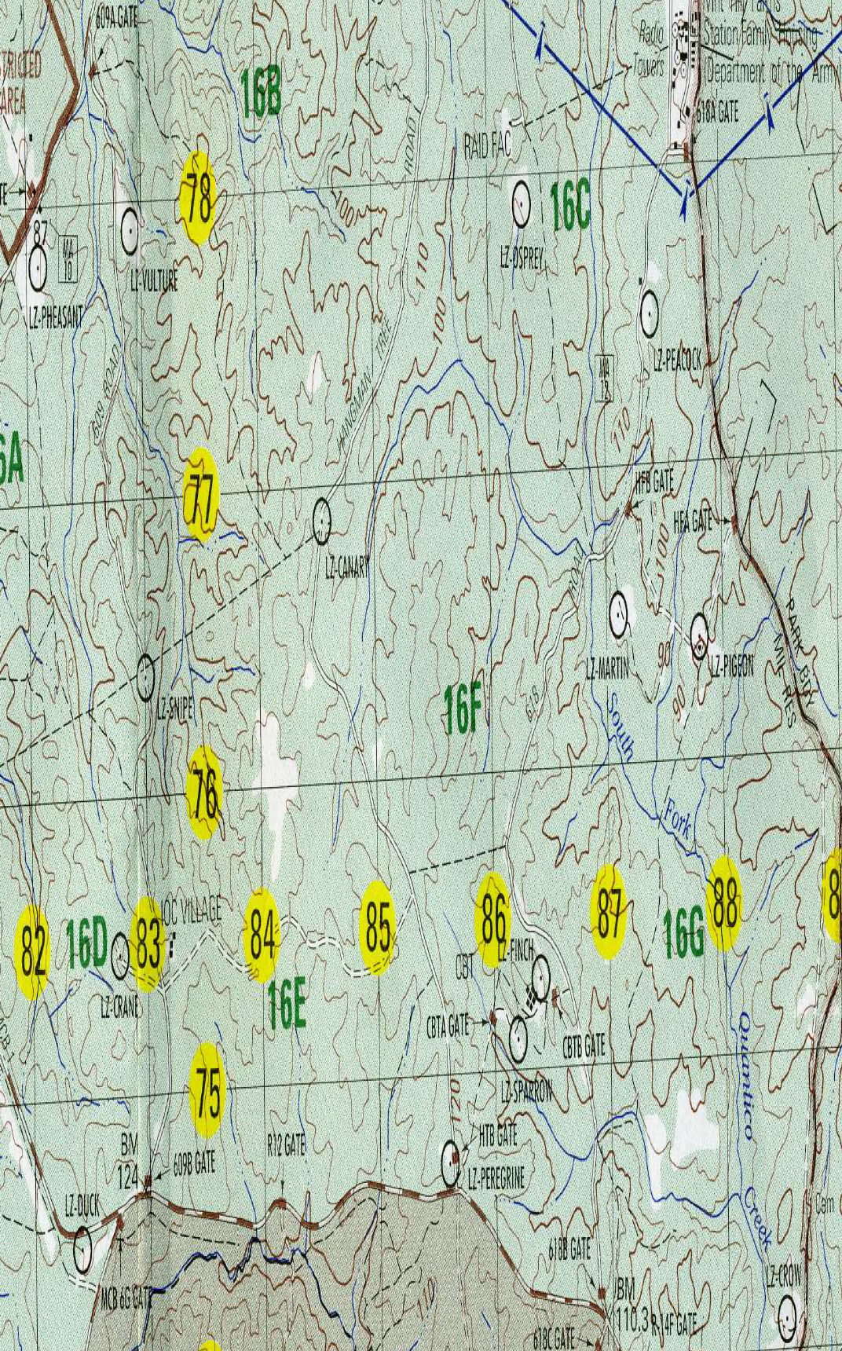
TH 845 768

Slide 8
POSREP
Position Report
  You are 3d Plt, A Co, 1/8
  Your higher is A Co, 1/8
  HHQ call word is Arrowhead
  Your call word is Arrowhead “3”
  You are located at LZ Canary (TH 845 768)
  You are establishing local security
Send the COC a position report (PosRep)

Slide 9
POSREP
Arrowhead
Arrowhead 3
TH 845 768
Currently establishing security

Slide 10
Enemy Sighting Report (SPOTREP)
SPOT Report
  Time is 1630 GMT and date is 09 July 2011
  You are 3d Plt, A Co, 1/8
  Your higher is A Co, 1/8
  HHQ call word is Arrowhead
  Your call word is Arrowhead “3”
  You are located at LZ Canary (TH 845 768)
  You are establishing local security
  You last received SML ARMS Fire from a FT size element at 1610 GMT. Enemy located ~TH 845 770
  One KIA and three WIA
  EKIA is unknown
Send the COC a SPOTREP

Slide 11
Arrowhead
Arrowhead 3
091630Z JUL 11
TH 845 770
Hasty 180 oriented North
2
1
Hasty 180 oriented North
None (Omitted)
None (Omitted)

Slide 12
SALUTE REPORT
SALUTE Report
  Time is 1630 GMT and date is 09 July 2011
  You are 3d Plt, A Co, 1/8
  Your higher is A Co, 1/8
  HHQ call word is Arrowhead
  Your call word is Arrowhead “3”
  You are located at LZ Canary (TH 845 768)
  You are establishing local security
  You last received SML ARMS Fire from a FT size element at 1610 GMT. Enemy located ~TH 845 770 wearing Tan MARPAT
  One KIA and three WIA
  EKIA is unknown
Send the COC a SALUTE Report

Slide 13
SALUTE REPORT
Arrowhead
Arrowhead 3
FT
Egressing North
TH 845 770
Tan MARPAT
1610 GMT
Small Arms

Slide 14
Landing Zone Brief
LZ Brief
  You are 3d Plt, A Co, 1/8
  Your higher is A Co, 1/8
  Pilot Call sign is “Eurotrash”
  Your Call Word is Arrowhead “3”
  You are located at LZ Canary (TH 845 768)
  Wind is coming from the South to North
  Azimuth from South to North is 360 degrees
  You estimate wind at 5 Knots
  LZ Canary MSL is 450 ft
Send the pilot a LZ Brief

Slide 15
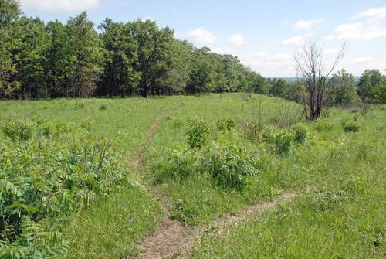
LZ Canary: TH 845 768
500 m
600 m
N

Slide 16
LZ Brief
Eurotrash
Arrowhead 3
TH 845 768
SMOKE

Slide 17
South
5 KNTS
450 ft
500
600
N
Low lying Grass
No Slope
40’ trees on the northern end
SML ARMS FRM N
1610 GMT

Slide 18
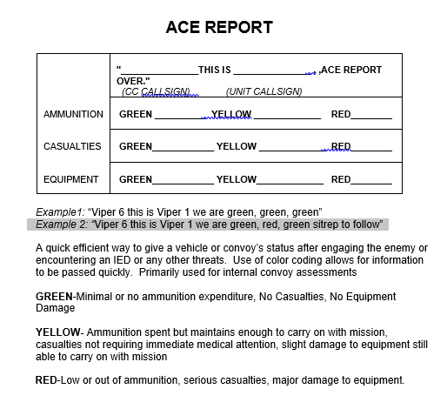

Slide 19
Questions?
Captain Lawrance Andrus
Lawrance.andrus@usmc.mil

