Slide 1
RTLC 1-17
DTS Instructions
POC GySgt Froio, Jeremy
760-763-7184
Cell 602-301-2888
Jeremy.froio@usmc.mil

Slide 2
RTLC DTS Setup
STUDENTS WILL NOT BE ALLOWED TO CHECK IN IF THEY DO NOT BRING A COPY OF THEIR SIGNED DTS AUTHORIZATION
RTLC is a unique course requiring your DTS authorization to be completed in a specific way. This will alleviate completely changing the itinerary in the voucher.
Ensure you begin and end your trip at your duty station and input the following for your multiple destinations.

Slide 3
RTLC DTS Authorization Locations
Use the following when inputting your itinerary. Select 1200 for all your times that follow your initial departure from your duty station. For departure upon graduation each Bn knows what works best for their schedule, input a time as necessary.
The only flights needed to be booked through DTS are your flight to the course and your flight back to your unit.
Phase I: Camp Pendleton, CA (1)
08 Mar through 31 Mar 2017
Phase II: Yuma, AZ
31 Mar through 17 Apr 2017
Phase III: Honolulu, HI
17 Apr through 08 May 2017
Phase IV: Camp Pendleton, CA (2)
08 May through 11 May 2017 (Grad date)

Slide 4
DTS Entitlements
When at the “EXPENSES” tab click “PER DIEM ENTITLEMENTS” Using the dates below, adjust CPEN(1) phase in the following manner.
Phase I: Camp Pendleton, CA
08 Mar through 31 Mar 2017
Lodging: $0.00, click “QUARTERS AVAILABLE”
Under “Select one of the following” Check “NONE”
Under “Meals” Check “AVAILABLE” and CHECK “BREAKFAST, LUNCH AND DINNER” (1st Recon will not receive funding from TECOM for GMR while at Pendleton due to the course beginning on their primary duty station location.)

Slide 5
DTS Entitlements
When at the “EXPENSES” tab click “PER DIEM ENTITLEMENTS” Using the dates below, adjust Yuma phase in the following manner.
Phase II: Yuma, AZ
01 Apr through 16 Apr 2017
Lodging: $0.00, click “FIELD CONDITIONS”
Under “Select one of the following” Check “NONE”
Under “Meals” Check “FULL RATE”
Due to field conditions no matter what you check it will be $0.00 for Per Diem

Slide 6
DTS Entitlements
When at the “EXPENSES” tab click “PER DIEM ENTITLEMENTS” Using the dates below, adjust Honolulu phase in the following manner.
Phase III: Honolulu, HI
17 Apr through 08 May 2017
Lodging: $0.00, click “QUARTERS AVAILABLE”
Under “Select one of the following” Check “NONE”
Under “Meals” Check “FULL RATE”

Slide 7
DTS Entitlements
When at the “EXPENSES” tab click “PER DIEM ENTITLEMENTS” Using the dates below, adjust CPEN(2) phase in the following manner.
Phase IV: Camp Pendleton, CA
08 Nov through 10 Nov 2016
Lodging: $0.00, click “QUARTERS AVAILABLE”
Under “Select one of the following” Check “NONE”
Under “Meals” Check “AVAILABLE” and CHECK “BREAKFAST, LUNCH AND DINNER”

Slide 8
DTS Entitlements
By following the above guidelines the break down should reflect:
Phase I: $18.85 per day (1st Recon will not rate due to PDS)
Phase II: $0 per day
Phase III: $123 per day
Phase IV: $18.85 per day (1st Recon will not rate due to PDS)
Do not modify the travel day, IE date leaving unit, date returning, and flight dates during the class.

Slide 9
Variations Authorized
Input Variations authorized in the review/sign and other auths. tab. This will make changes in location by date and mode of travel throughout the course easy on the back-end.
Screen shots on following slides

Slide 10
Screenshots
The following slides depict a screen shot for each phase in order as they will occur. Listed at the top is the location. Ensure all dates for the specific location reflect the same entitlement as depicted by the screenshots.

Slide 11
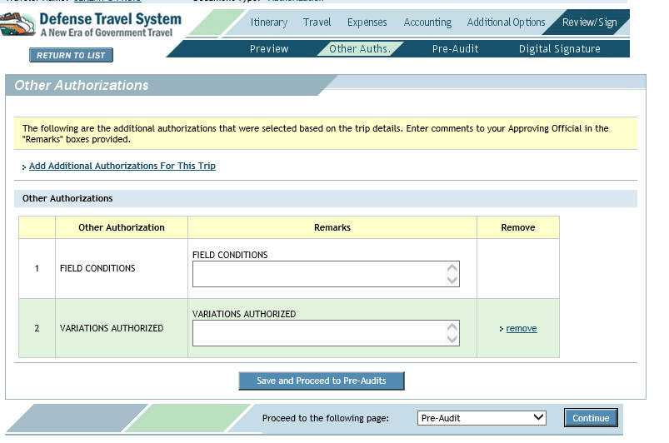
Variations Authorized

Slide 12
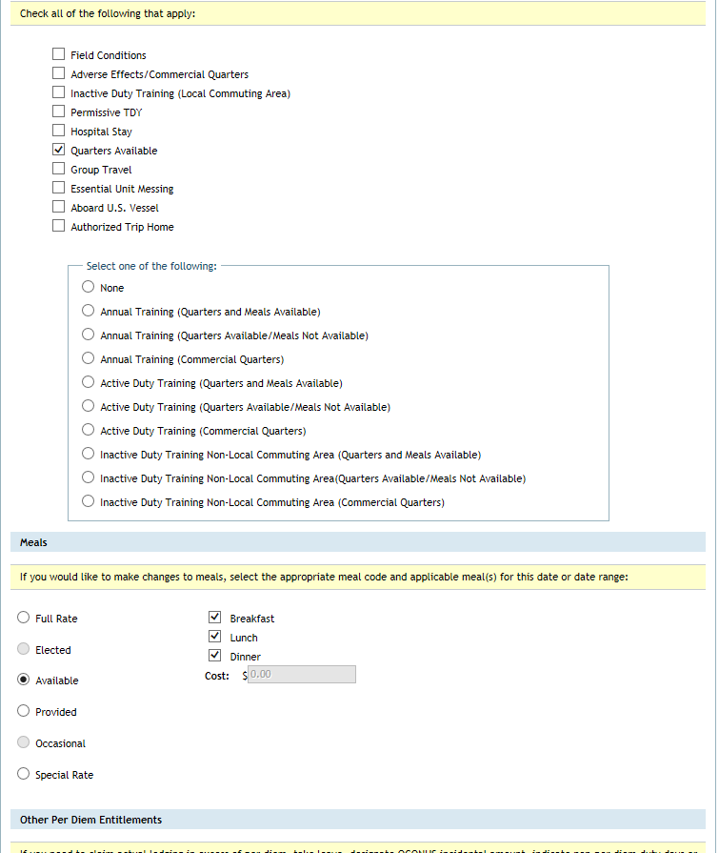
DTS Entitlements CAMP PENDLETON

Slide 13
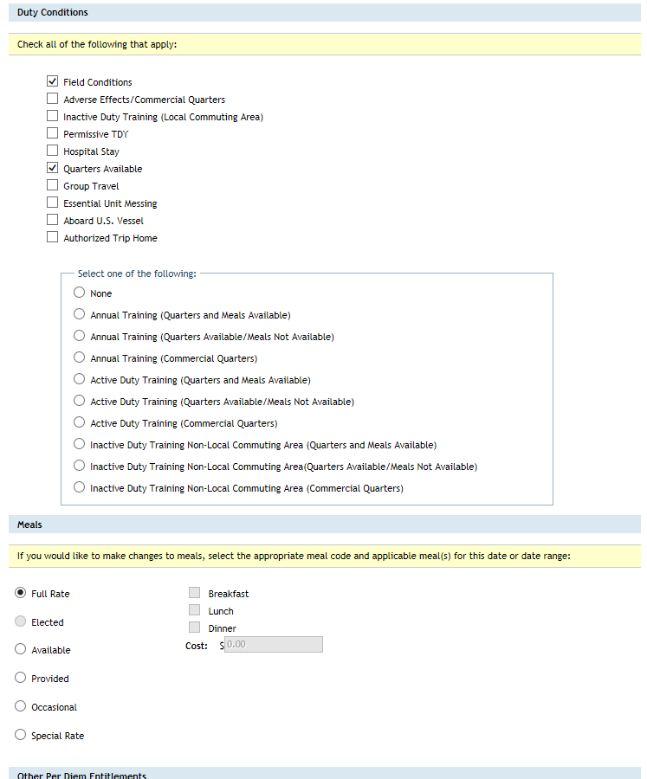
DTS Entitlements YUMA

Slide 14
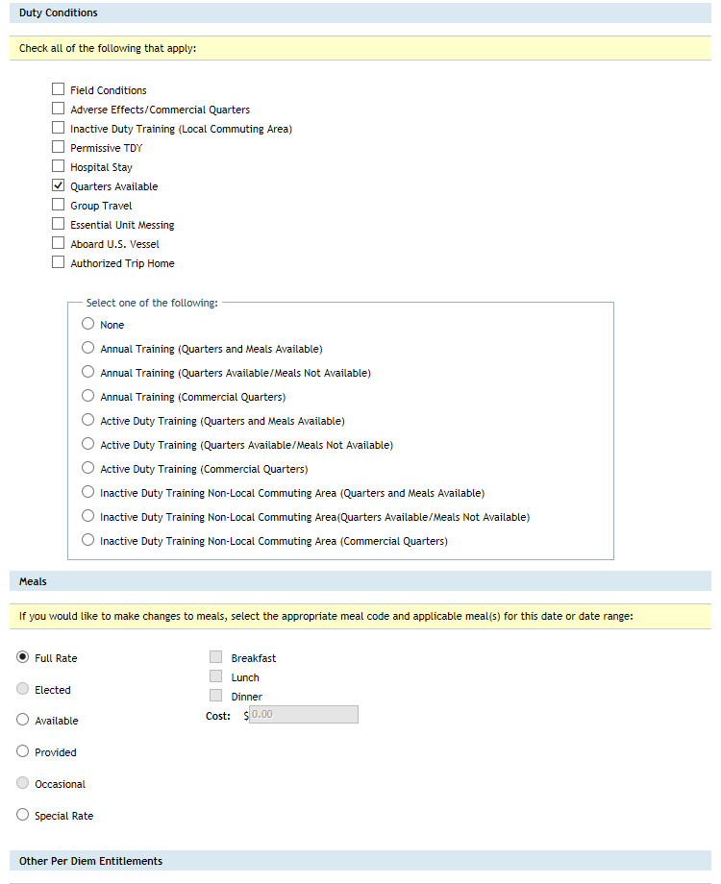
DTS Entitlements HAWAII

Slide 15
DTS Voucher
Detaching Endorsement will be provided from the SOI (W) regiment showing that there is cost to the government. Follow these directions to a “T” for RTLC 1-17, they have been vetted at TECOM, and are WWT funded as long as the authorization was completed with the WWT Funding Letter attached with SNM listed on the Funding Letter.

Slide 16
DTS Issues
There have been numerous issues with DTS from all commands who have sent students to RTLC.
Follow the guidance given for the authorization. Small changes to the voucher will be easy. Our POI supports offsite training anywhere in the US so approve their locations and entitlements as described in the previous slides and the DTS process should go smoothly.
I have done the leg work for you so please don’t just put “meals available” for the entire course and change on the back end. Do an honest voucher that depicts the actual cost of the DTS orders rather than surprising TECOM with a voucher astronomically higher than the authorization.

Slide 17
POC
For any question regarding your DTS please contact:
RTLC SNCOIC
GySgt Froio, Jeremy
(w) 760-763-71834
© 602-301-2888

