Slide 1
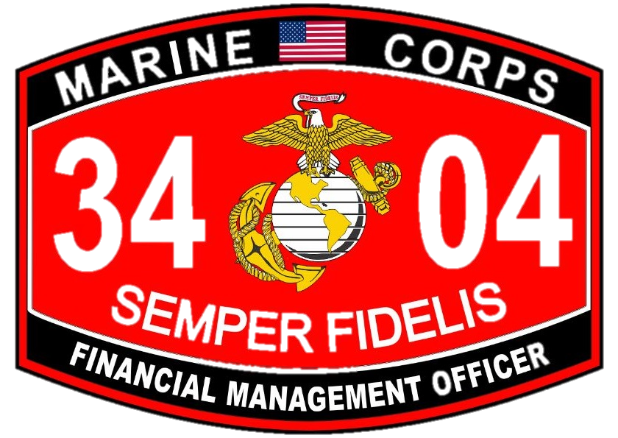
Financial Management School 9 October 2018

Slide 2
Purpose of Smart Pack
The purpose of this document is to provide Officers who have been assigned the Financial Management Officer Military Occupational Specialty (MOS) of 3404 with a basic understanding of the roles and responsibilities of their appointed occupation. The 3404 MOS is a technical field that requires advanced level problem solving skills, critical thinking, and a broad understanding of Marine Corps operations and business processes. There are two functional areas within the Financial Management MOS; Disbursing and Comptroller. Financial Management Officers will work in either the Disbursing or Comptroller Field at various points throughout their career.
Financial Management School 9 October 2018

Slide 3
What is a 3404?
Official MOS Manual Definition
Financial Management Officers formulate and supervise the execution of policies and procedures pertaining to the financial management of appropriated funds in the operating forces and the shore establishment. The functional areas of assignment are: budget formulation and execution, finance, and resource evaluation and analysis.
(Comptroller) Budget formulation and execution duties include supervising the operations of a budget office or section; providing guidance for formulation of budgets; compiling budget estimates; and reviewing and monitoring budget performance and execution.
(Disbursing) Finance duties include supervising the operations of a finance office or section within a finance office; providing guidance procedures; ascertaining the validity of disbursements and the collection of public funds; and supervising and directing the legal expenditure of public funds.
(Comptroller) Resource evaluation and analysis functions may include the evaluation and analysis of resource management issues and problems; work station inspections; and external audits liaison.
Financial Management School 9 October 2018

Slide 4
What is a Comptroller Office?
A Comptroller office maintains financial resources required to equip, train, deploy and maintain combat ready MAGTFs/forces in order to meet Combatant Commander requirements across the full range of military operations. Additionally, the Comptroller office maintains sound financial systems, processes, and internal controls to ensure efficient, effective, and legal expenditure of financial resources and accurately account for funds.
Financial Management School 9 October 2018

Slide 5
Comptroller Office Structure
Comptroller
Comptroller
Chief
Deputy
Comptroller
Civilian or
Lieutenant
RE&A
FMRO
Budget
Officer
Accounting
Chief
Assistant
Budget/Exercise
Officer
Financial
Management
Resource
Analyst Section
Financial Management School 9 October 2018

Slide 6
What can I expect at work as a Comptroller?
2ndLt & 1stLt:
Daily work will consist of authorizing resources to subordinate commands, analyzing financial execution data, identifying deviations, conducting root cause and trend analysis, and leading the budget formulation process.
Captain:
Daily work will consist of forecasting fiscal requirements for future years, assembling Resource Working Groups (RWG) for critical events, ensuring fiscal resources support the Command’s overall mission, and applying the tenants of appropriations law to the decision-making process.
Financial Management School 9 October 2018

Slide 7
Comptroller Duty Assignments
West Coast:
Camp Pendleton
Miramar
Bridgeport
San Diego
East Coast:
Camp Lejeune
Cherry Point
Quantico
Pentagon
Parris Island/ Beaufort
Tampa
Miami
Norfolk
Overseas:
Okinawa
Iwakuni
Germany
Hawaii
Korea
Financial Management School 9 October 2018

Slide 8
What is a Disbursing Office?
A Disbursing Office processes travel, pay, and vendor pay vouchers in garrison and during deployed operations.
Travel vouchers include accession pipeline, permanent change of station, and temporary duty vouchers.
Pay vouchers include military pay and adjustments, separations pay, and allotments.
Vendor payments include processing payments for base services and for cash payments made by deployed disbursers and units.
Financial Management School 9 October 2018

Slide 9
Disbursing Office Structure
DO
Disbursing
Chief
ADO
Operations
Fiscal
Internal
Controls
Pay/Seps
DTS/DMM
Travel
Productions
Reports/DMM
Productions
IPAC
Customer Svc
Financial Management School 9 October 2018

Slide 10
What can I expect at work as a Disburser?
2ndLt & 1stLt:
Daily work will consist of on-the-job training, certifying documents for payment, attending section coordination meetings, addressing customer service calls and emails, scheduling training, and personnel management. Lt Disbursing officers will typically be responsible for 10-20 Marines.
Captain:
Daily work will consist of certifying documents for payment, personnel management, coordination with other sections to conduct training and inspections, and compiling data from the section for various reports. Disbursing Captains will typically be responsible for 40-60 Marines.
Financial Management School 9 October 2018

Slide 11
DO/FO Assignments
West Coast:
Camp Pendleton
San Diego
East Coast:
Camp Lejeune
Quantico
Parris Island
Overseas:
Okinawa
Hawaii
Financial Management School 9 October 2018

Slide 12
Deployment Opportunities
Whenever and wherever a MAGTF deploys, Comptroller and Disbursing skillsets are required to support the mission. Current 3404 deployment opportunities are:
Special Purpose MAGTF
Marine Expeditionary Units
Supporting units in Afghanistan
Supporting units in Iraq/Syria
Korea
Other Individual Augment (IA) billets, e.g. advisor billets in Pakistan or Kuwait.
Financial Management School 9 October 2018

Slide 13
Common Acronyms
DAI: Defense Agency Initiative
ARMS: Access Request Management Service
MSC: Major Subordinate Command
REA: Research, Evaluation, and Analysis
FMRO: Financial Management Resource Office (or Officer)
FMRA: Financial Management Resource Analyst
RFA: Resources, Finance, Accounting (Headquarters Marine Corps accounting office)
DTS: Defense Travel System
GCSS - MC: Global Combat Support System – Marine Corps
Financial Management School 9 October 2018

Slide 14
What Resources are Available Now? OPEN SOURCE
Financial Management School webpage
https://www.trngcmd.marines.mil/Units/South-Atlantic/MCCSSS/MCCSSS-Schools/Financial-Management/
Marine Corps Combat Service Support Schools (MCCSSS) webpage
https://www.trngcmd.marines.mil/Units/South-Atlantic/MCCSSS/
MCCSSS Facebook page
http://www.facebook.com/MCCSSS/
Marine Corps Financial Management Standard Operating Procedures
https://www.marines.mil/Portals/59/MCO_7300.21B_FINAL_SIGNED.pdf
Department of Defense Financial Management Regulations (DoDFMR)
https://comptroller.defense.gov/fmr/
Joint Travel Regulations (JTR)
https://www.defensetravel.dod.mil/site/travelreg.cfm
Department of Defense, Financial Management Certification website
https://fmonline.ousdc.osd.mil/default.aspx
Financial Management School 9 October 2018

