Slide 1
Finance Technician 3432
Financial Management School 31 July 2023

Slide 2
Finance Technician
Finance technicians perform the duties associated with the maintenance, review, payment processing of master pay accounts, and the fiscal accounting supporting those transactions. Finance technicians also perform duties incident to the adjudication, computation, review, and payment of vouchers of reimbursement for official travel.
Tasks performed by Finance Technicians can include the following: Validate the Characteristics of a Line of Accounting (LOA); Prepare a Disbursing Diary; Compute Adjustments to Pay and Allowances; Compute Deductions and Collections of Pay; Compute Special Payments; Prepare a Special Payroll; Process a Decentralized and Centralized Regular Payroll; Maintain Correspondence Files and Directives; Conduct Forward Deployed Finance Operations; Manage Suspense Accounts; Prepare Daily Statement of Accountability (DD 2665); Audit Collection Vouchers.
Financial Management School 31 July 2023

Slide 3
Finance Technician
Finance Technicians perform a unique role within the Marine Corps and are typically located at the larger installations. They can be stationed at any of the Marine Expeditionary Forces, the Recruit Depots, Hawaii, or in the National Capitol Region.
More specific information on the duty locations is on the following slide.
Financial Management School 31 July 2023

Slide 4
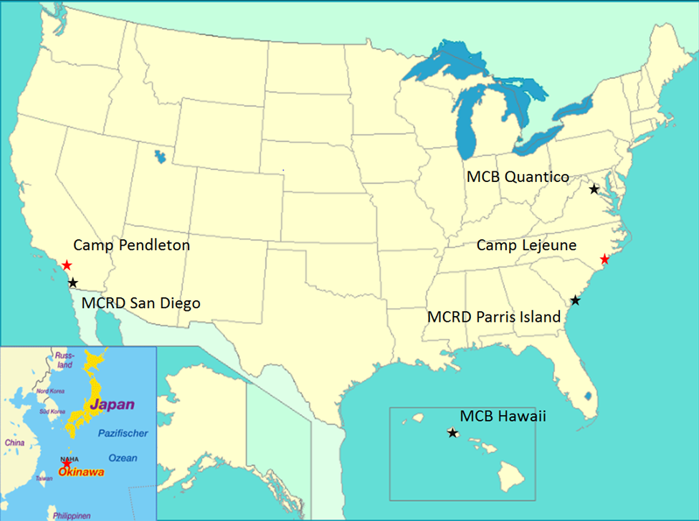
Disbursing Office
Finance Office
Financial Management School 31 July 2023

Slide 5
Links
Financial Management School webpage
https://www.trngcmd.marines.mil/Units/South-Atlantic/MCCSSS/MCCSSS-Schools/Financial-Management/
Marine Corps Combat Service Support Schools (MCCSSS) webpage
https://www.trngcmd.marines.mil/Units/South-Atlantic/MCCSSS/
MCCSSS Facebook page
http://www.facebook.com/MCCSSS/
Financial Management School 31 July 2023

