Slide 1
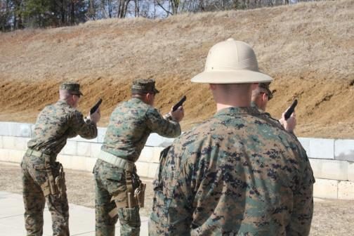
CPP Overview
1

Slide 2
Purpose
The purpose of this brief is to provide CMT’s information on the development of the Combat Pistol Program (CPP) and significant changes to doctrinal techniques.
1

Slide 3
Agenda
Background
Development
Differences (ELP, CPP)
Training Constraints
Standardized Basic Skills
Training Blocks
Targetry/Scoring Methodology
1

Slide 4
Background
Since 1992 the Marine Corps has made continuous efforts to improve pistol marksmanship training.
Each attempt was met with friction due to time or resources restrictions. A renewed effort, begun in 2008 resulting in the recently approved Combat Pistol Program (CPP) in 2013.
1

Slide 5
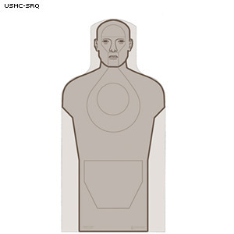
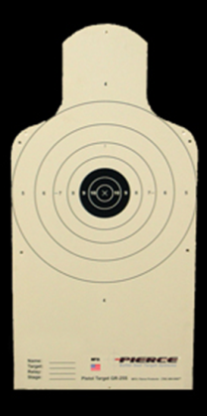
Development
In 2008 MPMS held a SME conference to capture current training and employment techniques from operational units to use in the development of fleet wide, executable Pistol Program. The resulting program used rifle tables 1&2 as a model to first train fundamental skills and then basic combat engagement techniques.
Table 1
Table 2
1

Slide 6
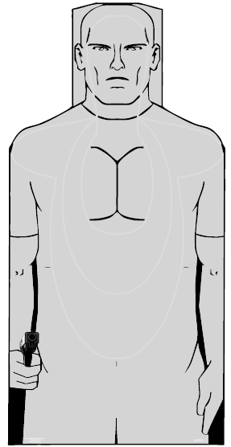
Development Cont.
Continued Testing and Evaluation revealed that using bullseye targetry contributed to problems with anticipation in some shooters.
An effort to improve targetry to meet both fundamental skills and basic combat engagement techniques resulted in the development of the MPMS-1 Target.
1
Notes:
Add MPMS-1 Target Graphic

Slide 7
Development Cont.
Testing and Validation of the program was completed during FY-12, and the decision to implement the program Marine Corps wide was made in FY-13.
To date, 11 annual training details and 9 entry-level details have been successfully executed aboard WTBN Quantico.
1

Slide 8
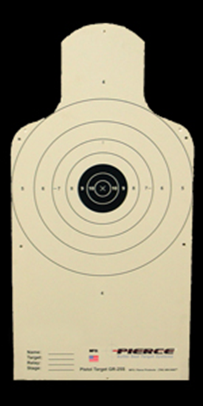
Differences
ELP
Focus:
Safe Weapons Handling
Fundamentals shot delivery techniques, using a bull’s-eye target.
CPP
Focus:
Train a Marine to effectively employ his pistol against the common threat.
1

Slide 9
Differences Cont.
ELP
Begins with fundamentals
Transitions to firing techniques:
Slow Fire
Quick Fire
Quick Reaction
Sustained Fire
CPP
Begins with fundamentals.
Transitions to effective engagement techniques:
Controlled Pairs
Failure to Stop
1

Slide 10
Differences Cont.
ELP
Conducts all drills from the Alert.
CPP
After refinement of fundamental skills, conducts all drills from the holster.
1

Slide 11
Differences Cont.
ELP
Does not allow time for effective coaching during live fire training
CPP
Requires coach participation in skill refinement during Training Blocks 1 and 2
1

Slide 12
Training Constrains
Range
Ammunition
Targetry
Time
1
Notes:
Range: 7, 15, 25 yd lines
Ammunition: 200 rds
Targetry: Turning Required (MPMS-1 Face)
Time: Inside existing allocation by unit. 5 Training Blocks

Slide 13
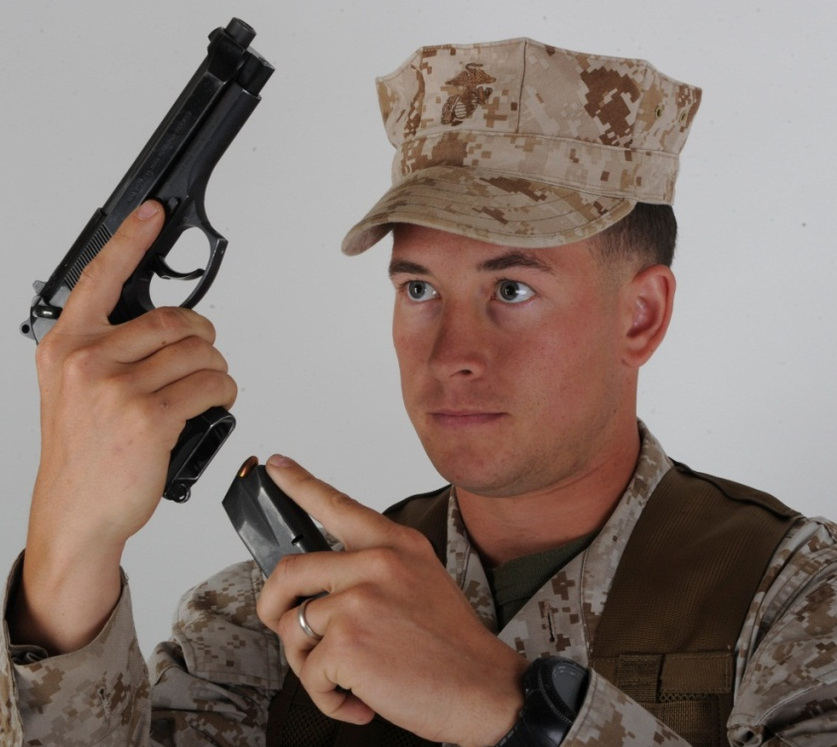
Standardized Basic Skills
Weapons Handling
“In your Workspace”
1

Slide 14
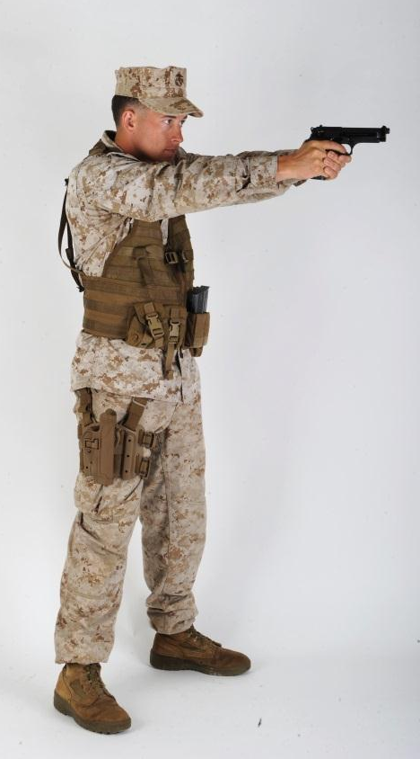
Standardized Basic Skills
Stance and Grip
Isosceles stance
High, two handed grip
1

Slide 15
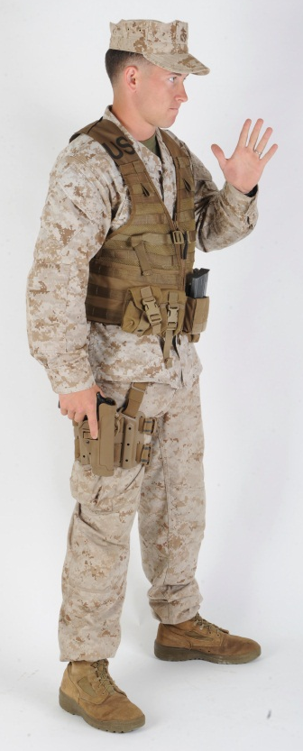
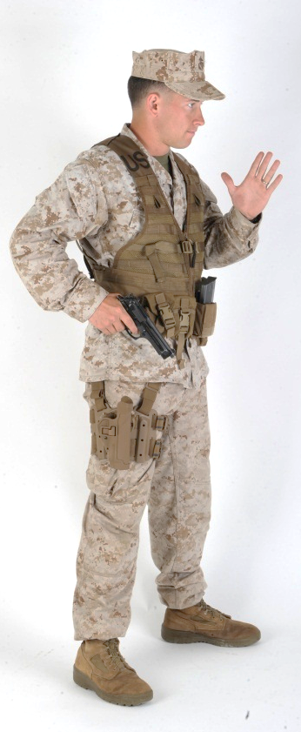
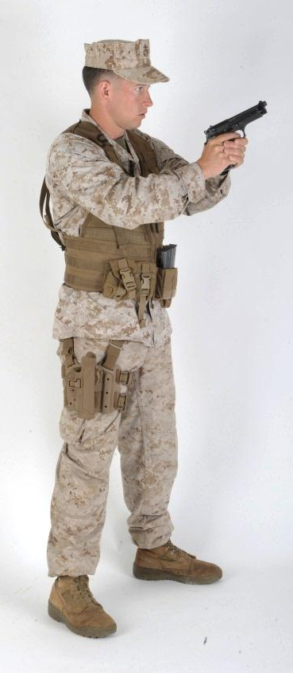
Standardized Basic Skills
Presentation
Four step draw
1

Slide 16
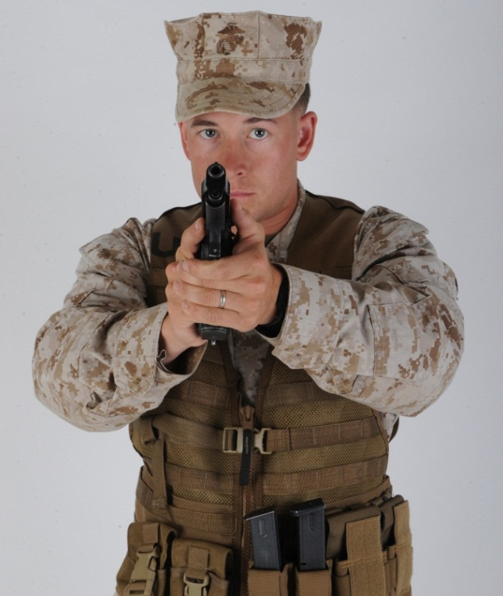
Standardized Basic Skills
Search and Assess
At the “Ready”
1

Slide 17
Training Blocks
Training Block 1
Weapons handling
Standing position and grip
Fundamentals
Techniques of fire:
Double and single action
Corrective action as necessary
1

Slide 18
Training Blocks
Training Block 2
All Skills in Block1, Plus:
Presentation from the holster
Controlled Pairs
Tactical Reloads
Speed Reloads
1

Slide 19
Training Blocks
Training Block 3
All previous skills plus:
Failure to Stop
Threat Assessment
1

Slide 20
Training Blocks
Training Blocks 4 and 5
Single Course of Fire
Encompassing all skill sets
Fired once for practice
Fired once for evaluation (score)
1

Slide 21
CPP Training Block One
Iterations | Total Rounds | Time | Mode | Fill Plan
Stage Two – 7 yards
1 (5 times) | 5 | NA | Single Action Slow Fire from Ready | NA
1 (10 times) | 10 | NA | Double Action from Ready | NA
Stage Two – 15 yards
1 (5 times) | 5 | NA | Single Action Slow Fire from Ready | NA
1 (10 times) | 10 | NA | Double Action from Ready | NA
Stage Three – 25 yards
1 (10 times) | 10 | NA | Single Action Slow Fire from Ready | NA

Slide 22
CPP Training Block Two
Iterations | Total Rounds | Time | Mode | Fill Plan
Stage Two – 7 yards
2 (4 times) | 8 | 7 sec | Controlled Pair from Holster | Load 10 in weapon; 4 in pouch
2 2 (2 times) | 8 | 11 sec | Speed Reload from Holster | 2 in weapon; 4 in pouch After 1st drill, fill mag w/7 After 2nd drill, fill mag w/5 Analyze & repair
Stage Two – 15 yards
2 (4 times) | 8 | 8 sec | Controlled Pair from Holster | 5 in weapon; 5 in pouch After 2nd drill, Tactical reload w/mag 5 After 4th drill, fill mag w/4
2 2 (2 times) | 8 | 14 sec | Speed Reload from Holster | 2 in weapon; 4 in pouch After 1st drill, fill mag w/10 Analyze & repair
Stage Three – 25 yards
1 (8 times) | 8 | NA | Coaches Time Single Action Slow Fire from Ready | 8 in weapon Analyze & repair

Slide 23
CPP Training Block Three
Iterations | Total Rounds | Time | Mode | Fill Plan
Stage One – 7 yards
2 | 2 | 5 sec | Controlled Pair from Holster | Load 10 in weapon; 4 in pouch
2 1 (2 times) | 6 | 7 sec | Failure to Stop from Holster | 8 in weapon; 4 in pouch
2 2 (2 times) | 8 | 9 sec | Speed Reload from Holster | 2 in weapon; 4 in pouch After 1st drill, fill mag w/7 After 2nd drill, fill mag w/5 Analyze & repair

Slide 24
CPP Training Block Three (cont.)
Iterations | Total Rounds | Time | Mode | Fill Plan
Stage Two – 15 yards
2 (4 times) | 8 | 6 sec | Controlled Pair from Holster | 5 in weapon; 5 in pouch After 2nd drill, Tactical reload w/mag 5 After 4th drill, fill mag w/4
2 2 (2 times) | 8 | 12 sec | Speed Reload from Holster | 2 in weapon; 4 in pouch After 1st drill, fill mag w/10 Analyze & repair
Stage Three – 25 yards
1 (8 times) | 4 | 7 sec | Single Action Slow Fire (Threat Assessment) from Ready | 8 in weapon Analyze & repair

Slide 25
CPP Table One – Training Blocks Four and Five
Iterations | Total Rounds | Time | Mode | Fill Plan
Stage One – 7 yards
2 (3 times) | 6 | 5 sec | Controlled Pair from Holster | Load 14 in weapon; 9 in pouch Analyze & repair
2 1 (2 times) | 6 | 7 sec | Failure to Stop from Holster | 8 in weapon; 9 in pouch Analyze & repair
2 2 | 4 | 9 sec | Speed Reload from Holster | 2 in weapon; 9 in pouch Fill mag w/7 Analyze & repair

Slide 26
CPP Table One – Training Blocks
Four and Five (cont.)
Iterations | Total Rounds | Time | Mode | Fill Plan
Stage Two – 15 yards
2 (6 times) | 12 | 6 sec | Controlled Pair from Holster | 7 in weapon; 7 in pouch After 3rd drill, Tactical Reload w/ mag 7 Fill mag w/10 Analyze & repair
2 2 | 4 | 12 sec | Speed Reload from Holster | 2 in weapon; 10 in pouch Analyze & repair
Stage Three – 25 yards
1 (8 times) | 8 | 7 sec | Single Action Slow Fire (Threat Assessment) from Ready | 8 in weapon Analyze & repair
Total rounds = 40

Slide 27
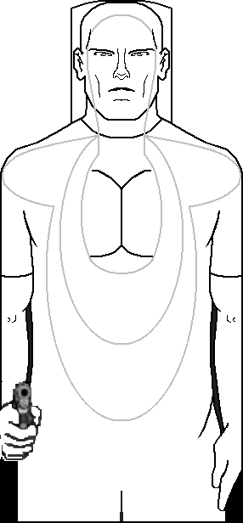
MPMS-1 Target
D
A
D
D
A = 10 points
B = 8 points
C = 6 points
D = 4 points
A
C
C
A
D
D
B
C
D

Slide 28
Failure to Stop – Chest Shot
4 points
A hit anywhere
on head
C
C
A
D
D
A = 10
B = 8
C = 6
D = 4
Designated
aiming area
is Center Mass
B
C
D

Slide 29
Failure to Stop – Head Shot
D
4 points
A
10 points
A hit outside the scoring zone but
inside the outline of the head
0
Miss
A hit outside the
outline of the head
0 points
Designated
aiming area
is Head
A hit anywhere
on the torso of the target

Slide 30
Table One Qualification Standards
Classification | Score
Expert | 364 – 400
Sharpshooter | 324 – 363
Marksman | 264 – 323
Unqualified | 0 – 263

Slide 31
Questions?
1

