Slide 1
ZERO A MINI INTEGRATED POINTER ILLUMINATOR MODULE (MIPIM) TO A SERVICE RIFLE/INFANTRY AUTOMATIC RIFLE

Slide 2
OVERVIEW
Design of the laser aiming device
Mounting the laser aiming device
Zeroing the laser aiming device
Weapons presentation

Slide 3
TERMINAL LEARNING OBJECTIVE
(1) Given a service rifle/Infantry Automatic Rifle (IAR), sling, Mini-Integrated Pointer Illuminator Module (MIPIM), night vision device, individual field equipment, magazines, ammunition, a target, and a dark environment, zero a Mini Integrated Pointer Illuminator Module (MIPIM) to a service rifle/Infantry Automatic Rifle to achieve point of impact on point of aim at a specific range (0300-M16-1010)

Slide 4
ENABLING LEARNING OBJECTIVE
(1) Given a service rifle, common combat sling, mini integrated pointer illuminator module, night vision device, individual field equipment, magazines, ammunition, a target, and a dark environment mount the MIPIM to the service rifle in order to achieve point of impact on point of aim at a specific range (0300-M16-1010a)

Slide 5
ENABLING LEARNING OBJECTIVE
(2) Given a service rifle, common combat sling, mini integrated pointer illuminator module, night vision device, individual field equipment, magazines, ammunition, a target, and a dark environment, set the MIPIM laser adjusters to the zero preset position in order to achieve point of impact on point of aim at a specific range (0300-M16-1010b)

Slide 6
ENABLING LEARNING OBJECTIVE
(3) Given a service rifle, common combat sling, mini integrated pointer illuminator module, night vision device, individual field equipment, magazines, ammunition, a target, and a dark environment, activate the MIPIM and direct the aiming laser on a target in order to achieve point of impact on point of aim at a specific range (0300-M16-1010c)

Slide 7
ENABLING LEARNING OBJECTIVE
(4) Given a service rifle, common combat sling, mini integrated pointer illuminator module, night vision device, individual field equipment, magazines, ammunition, a target, and a dark environment, make zeroing adjustments off 5-round shot groups in order to achieve point of impact on point of aim at a specific range (0300-M16-1010d)

Slide 8
Method/Media
Evaluation
Safety/Cease Training
Administrative Notes

Slide 9
?
What I will
Be
Teaching???
How I will
Be
Teaching???
How You will
Be
Evaluated???

Slide 10
DESIGN OF THE LASER AIMING DEVICE
The AN/PEQ-16 is a multifunction laser device that:
Emits visible or infrared light
Provides for target acquisition in low-light and close quarters combat situations
Provides for active, covert target acquisition
Can be handheld or weapon mounted
Also equipped with a white light

Slide 11
DESIGN OF THE LASER AIMING DEVICE
Specs | AN/PEQ-15 | AN/PEQ-16
Weight w/ Batteries | 7.5 oz | 9.9 oz
Length | 4.6 in | 4.1 in
Width | 2.8 in | 3.2 in
Height | 1.6 in | 1.7 in
Power Source | (1)3v DL123A | (2)3v DL123A
Battery Life | 6 hours dual high | 4 hours normal operation, <1 hour white light
Water Proof | 1 hour @ 6 meters | hour @ 6 meters

Slide 12
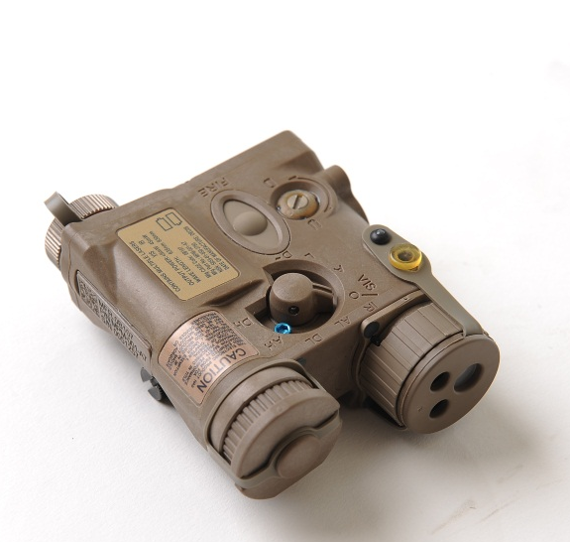
DESIGN OF THE LASER AIMING DEVICE
Label | Description
1 | Tri-Function Lens Cap
2 | IR Illuminator Focus Knob
3 | Infrared Illuminator
4 | Visible Aim Laser
5 | Infrared Aim Laser
6 | White Light Lens Cap
7 | White Light Illuminator/Focus Knob
8 | Illuminating Light Adjustors
9 | Safety Screw Storage Location
10 | Battery Cap/Battery Compartment
11 | LED Status Indicator
12 | Remote Jack/Jack Plug
13 | Activation Button
14 | Mode Selector
15 | Safety Screw
16 | Rail Grabber Bracket
17 | Tie-down Attachment Point
AN/PEQ-16 Components
10
8
13
2
16
9
14
15
12
11
17
7
6
4
5
3
1

Slide 13
DESIGN OF THE LASER AIMING DEVICE
Mode Selector Position
Position | Mode | Remarks
VIS AL | Visible Aim Class 3a | Visible Aim Laser is selected.
O | Off | The Device will not operate.
P | Program | Programming Mode is selected to set the desired Infrared (IR) Illuminator pulse rate.
AL | Aim Low Class 1 | IR Aim Laser is selected a low power.
DL | Dual Low Class 1/3a | IR Aim Laser and IR Illuminator are both selected at low power.
AH | Aim High Class 3b | IR Aim Laser is selected at high power.
IH | Illuminator High Class 3b | IR Illuminator is selected at high power.
DH | Dual High Class 3b | IR Aim Laser and IR Illuminator are both selected at high power.

Slide 14
DESIGN OF THE LASER AIMING DEVICE
Modes of Activation
Momentary Operation: Press and hold the Activation Button to operate the device. When the button is released, the device turns off.
Continuous Operation: Press twice in rapid succession (double-tap) to turn the device on. It will remain on until the button is pressed again. It will automatically turn off after five continuous minutes.
Remote Cable Switch: When installed, the Remote Cable Switch may be used to provide the same functionality as the Activation Button.

Slide 15
MOUNTING THE LASER AIMING DEVICE
The AN/PEQ-16 may be mounted on the top, left or right side of the rifle
If mounted on the side of the service rifle, the AN/PEQ-16 should be mounted on the outboard side (i.e., right-side mount for right-handed shooter) so the sling or gear does not interfere with its operation
Be aware, that if placed on the top, the device may be visible through the optic on the rifle

Slide 16
ZEROING THE LASER AIMING DEVICE
Adjustments
Mount | Adjuster | Rotation | Shot Group Movement
Top | Top Adjuster Elevation | CW CCW | Up Down
 | Side Adjuster Windage | CW CCW | Left Right
Left Side | Side Adjuster Windage | CW CCW | Left Right
 | Bottom Adjuster Elevation | CW CCW | Down Up
Right Side | Top Adjuster Elevation | CW CCW | Up Down
 | Side Adjuster Windage | CW CCW | Right Left
Or… start turning the adjuster, if it’s good, keep going. If not, go the other direction.

Slide 17
ZEROING THE LASER AIMING DEVICE
Preset Zero: within 4 inches vertically and horizontally of the mechanical axis of the weapon's barrel at 25 meters. To pre-zero:
Rotate both adjusters to the full counter-clockwise end of travel
Rotate them back 2.5 turns to align the slotted head in a 12 o'clock / 6 o'clock orientation

Slide 18
ZEROING THE LASER AIMING DEVICE
Co-Witness: used on a weapon with an established zero to get a quick and accurate zero at 100m
In a low-light or dark environment, establish an aiming point (small target or chem-light)
Aim at the target and adjust the visible laser to the 100m aiming point of the optic (i.e. tip of the RCO’s chevron)
This means that if the optic is zeroed to point of aim, point of impact at 100m, so now is the AN/PEQ-16.

Slide 19
WEAPON PRESENTATION
Ideally, the laser should be activated during presentation of the weapon
If the laser is activated prematurely or excessively, it will compromise the shooter’s position

Slide 20
SUMMARY
Design of the laser aiming device
Mounting the laser aiming device
Zeroing the laser aiming device
Weapons presentation

