Slide 1
DEMONSTRATE UNKNOWN DISTANCE THREAT ENGAGEMENT SKILLS (DAY)

Slide 2
OVERVIEW
SUPPORTED FIRING POSITIONS
DETERMINE RANGE
WEATHER CONSIDERATIONS
ENGAGE TARGETS AT UNKNOWN DISTANCE

Slide 3
TERMINAL LEARNING OBJECTIVE
Given a service rifle/ Infantry Automatic Rifle (IAR) with primary aiming device, individual field equipment, common weapon sling, magazines, ammunition, and threat targets at short, mid, and long range, achieve mastery during execution of the performance checklists within the Master Lesson Files for Entry-Level and Annual Rifle Marksmanship Training.

Slide 4
ENABLING LEARNING OBJECTIVE
Given a service rifle/ Infantry Automatic Rifle (IAR) with primary aiming device, individual field equipment, common weapon sling, magazines, ammunition, and threat targets at short, mid, and long range, engage targets from supported firing positions (standing, kneeling, and prone).

Slide 5
ENABLING LEARNING OBJECTIVE
Given a service rifle/ Infantry Automatic Rifle (IAR) with primary aiming device, individual field equipment, common weapon sling, magazines, ammunition, and threat targets at short, mid, and long range, determine the range to the threat.

Slide 6
ENABLING LEARNING OBJECTIVE
Given a service rifle/ Infantry Automatic Rifle (IAR) with primary aiming device, individual field equipment, common weapon sling, magazines, ammunition, and threat targets at short, mid, and long range, compensate for the effects of weather.

Slide 7
ENABLING LEARNING OBJECTIVES
Given a service rifle/ Infantry Automatic Rifle (IAR) with primary aiming device, individual field equipment, common weapon sling, magazines, ammunition, and threat targets at short, mid, and long range, apply engagement techniques (controlled pair, precision shot).

Slide 8
Method/Media
Evaluation
Safety/Cease Training
Admin Notes

Slide 9
QUESTIONS
What I will be
teaching?
How I will be
teaching?
How you will be
evaluated?

Slide 10
SUPPORTED STANDING
When the supported prone or kneeling position cannot be used to engage the target, the supported standing position may be used. The supported standing position is effectively used behind high cover (e.g., window, over a wall) or narrow cover (e.g., tree, telephone pole).

Slide 11
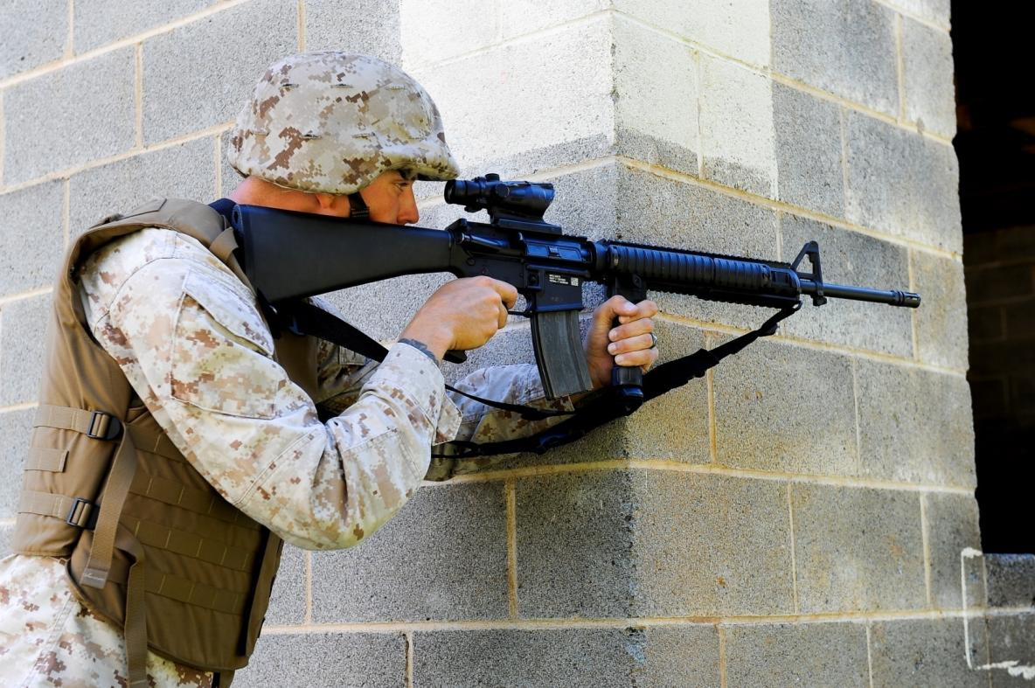
SUPPORTED STANDING CONT.

Slide 12
SUPPORTED KNEELING
When the prone position cannot be used because of the height of the support, the supported kneeling position may be appropriate. The kneeling position provides additional mobility over the prone position.

Slide 13
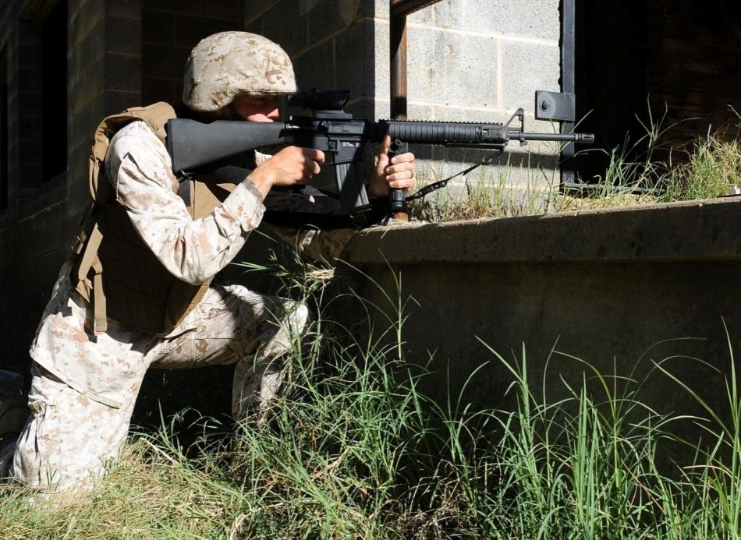
SUPPORTED KNEELING CONT.

Slide 14
SUPPORTED PRONE
Whenever possible, the supported prone position should be used when firing from behind cover. It is the steadiest position and provides the lowest silhouette, thereby providing maximum protection from enemy observation and fire.

Slide 15
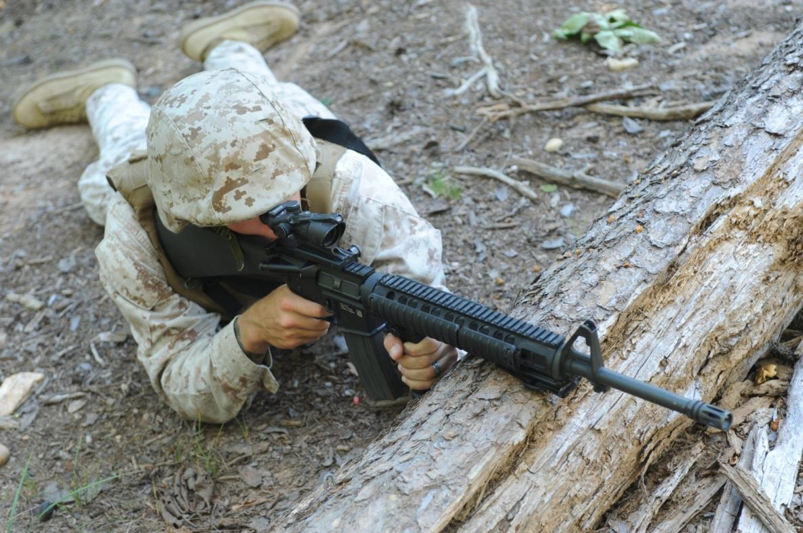
SUPPORTED PRONE CONT.

Slide 16
DETERMINING RANGE
Accurate range determination will allow the Marine to determine if the target can be effectively engaged using his BZO or if a new sight setting should be placed on the rifle.
There are many methods of range estimation that can provide accurate measurements. The most common are those methods that rely on the eye.

Slide 17
DETERMINING RANGE
Unit of Measure:
  The Marine must visualize a distance of 100 meters on the ground, and then estimate how many of these units can fit between himself and the target.
  The accuracy of this method is directly related to how much of the terrain is visible.
  Proficiency in the unit of measure method requires constant practice.

Slide 18
DETERMINING RANGE
Appearance of Objects Method:
  Must be familiar with the sizes and details of personnel and equipment at known distances.
  Anything that limits the visibility (such as weather, smoke, or darkness) will also limit the effectiveness of this method.

Slide 19
DETERMINING RANGE
Rifle Front Sight Post Method:
  The area of the target that is covered by the front sight post of the M16A2 rifle can be used to estimate range to the target.
  The service rifle front sight post will cover the width of a man's chest or body at approximately 300 meters.

Slide 20
DETERMINING RANGE
Rifle Combat Optic (RCO) Ranging:
  The chevron will cover the width of a man's chest (approximately 19” wide) at 300 meters.
  If the target is less than the width of the chevron, you should assume the target is in excess of 300 meters.
  The ranging feature is designed for the ideal situation where a target is exposing his torso and is facing you.

Slide 21
DETERMINING RANGE
Visible Detail Method:
  When observing a target, the amount of detail seen at various ranges gives the Marine a good indication of the target's distance.
  At 100 yards/meters, the target can be clearly observed in detail, and facial features can be distinguished.
  At 500 yards/meters, the body shape begins to taper at the ends. The head becomes indistinct from the shoulders.

Slide 22
DETERMINING RANGE
Bracketing Method:
  Estimating the shortest possible distance and the greatest possible distance to the target.
  Once the greatest and shortest distances have been determined find the average and that is roughly your distance to target.

Slide 23
WEATHER CONSIDERATIONS
The well‑trained shooter who understands how to obtain a steady position, carefully align their sights, and execute perfect trigger control may still fail to hit the center of the target.

Slide 24
WEATHER CONSIDERATIONS
Effects of Wind:
  The Shooter:
    The effect the wind has on the shooter will depend on the velocity of the wind and the firing position.
    The stronger the winds, the more difficult it will be to hold the weapon steady.
    If the situation permits, choose a shooting position that is the least susceptible to the effect of the wind. (i.e. prone)

Slide 25
WEATHER CONSIDERATIONS
Effects of Wind:
  The Bullet:
    The effect the wind has on the round as it travels down range is referred to as deflection.
    Increases with the distance to the target.
    FACTORS OF WIND:
      Velocity of the Wind
      Range to Target
      Direction of Wind

Slide 26
WEATHER CONSIDERATIONS
EFFECTS OF DIFFERENT LIGHT CONDITIONS:
  Bright Light. Bright light conditions exist under a clear blue sky with no fog or haze present to filter the sunlight.
    Place a piece of tape over the fiber optic light collector to create a finer aiming point on the red chevron and post below it.
    Bright light can make a target appear smaller and farther away. As a result, it is easy to overestimate range. Bright light can affect your perception of the target and therefore can affect your zero.

Slide 27
WEATHER CONSIDERATIONS
EFFECTS OF DIFFERENT LIGHT CONDITIONS:
  Haze: Haze exists when smog, fog, dust, or humidity is present. Hazy conditions could cause additional eye strain. Haze can make a target appear indistinct, making it difficult to establish sight picture.

Slide 28
WEATHER CONSIDERATIONS
Overcast:
  Overcast conditions exist when a solid layer of clouds blocks the sun.
  The amount of light changes as the cloud cover thickens.
  Overcast conditions make a target appear larger and closer.

Slide 29
WEATHER CONSIDERATIONS
Clouds:
  Scattered Clouds:
    Exist when the clouds are broken up into small patches with the sun appearing at times between the clouds.
    Your eyes may have problems adjusting between a target which is brightly lit and one that is shadowed.
      Moving Clouds:
        Exist when scattered clouds move across the sky rapidly.
        Can fatigue the eyes due to the rapid changes from bright light to shadows.

Slide 30
WEATHER CONSIDERATIONS
EFFECTS OF TEMPERATURE:
  Extreme Heat:
    Hot temperatures can lead to rapid fatigue and cause distractions that can result in inaccurate shooting.
    Excessive heat can cause muscle cramps, heat exhaustion, or heat stroke.
    ground mirage can cause a target to appear indistinct and drift from side to side.
    Rifle chamber pressure increases.
    Provides the bullet with less resistance allowing it to travel faster

Slide 31
WEATHER CONSIDERATIONS
EFFECTS OF TEMPERATURE:
  Extreme Cold:
    Extreme cold can cause you to shiver, feel uncomfortable, have lapses in memory, and difficulty holding a frigid rifle with numb hands.
    Rifle chamber pressure decreases, causing the bullet to exit the muzzle at a lower velocity and impact the target below the point of aim.
    Slow the speed of the bullet, causing the bullet to experience a greater deflection when there is wind.

Slide 32
WEATHER CONSIDERATIONS
HOLDS:
  To engage a target in wind conditions, a shooter may be required to aim their rifle at a point on the target other than center mass.
  Adjusting sight picture to compensate for the distance and size of the target.
  The RCO adjusters should not be adjusted for a wind change.

Slide 33
ENGAGE TARGETS AT UNKNOWN DISTANCE
Controlled Pair. For threats 50 yards and closer a controlled pair will be used to engage the threat. This requires three sight pictures and execution of the basic fundamentals of marksmanship.
Single Precision Shot. If a target is located at long range, or partially exposed, the Marine’s stability of hold and sight alignment are critical to accurately engage a threat utilizing a precision shot.

Slide 34
SUMMARY
SUPPORTED FIRING POSITIONS
DETERMINE RANGE
WEATHER CONSIDERATIONS
ENGAGE TARGETS AT UNKNOWN DISTANCE

