Slide 1
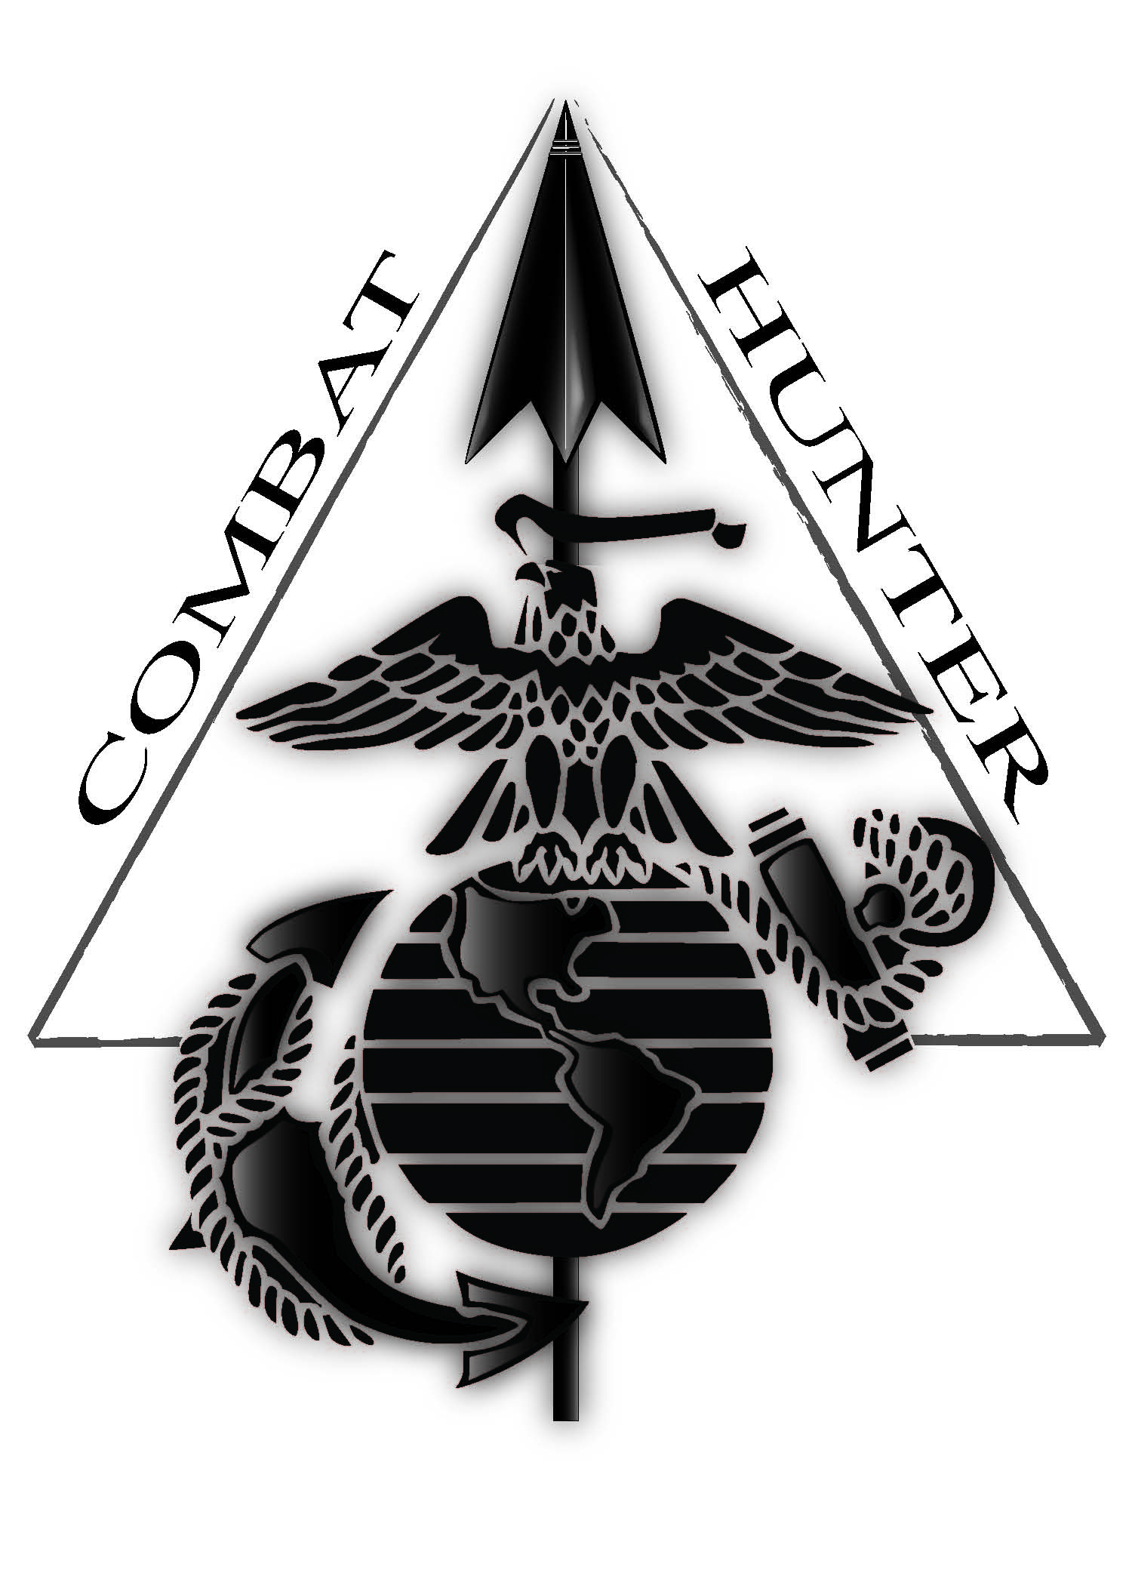
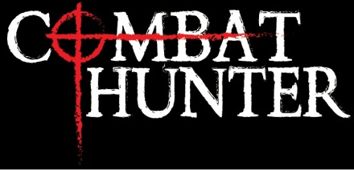
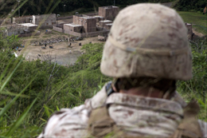
REVIEWS
“All Marines must know and use this language.” LtGen John A. Toolan
"The course is definitely a force multiplier for the Marine Corps and I hope to see this course expand, as it definitely will save Marines lives.“ MSgt Willenbecher
“I believe CH should be required by all Marines. It opens your eyes to not only the threats around you but the environment as a whole.” CH AMHS Survey FY13
Recommend that every Marine receive CH training if resources allow. Marines state Combat Hunter is a major factor in assisting them to deal with the IED threat and operate more effectively. 1stMARDIV Training Assessment FY13
"If Combat Hunter goes away we are setting up Marines to be victims...it will be a sad day if we divest ourselves of Combat Hunter." MGen Padilla
The purpose of the Combat Hunter Trainer Course is to produce a Marine capable of training a more ethically minded, tactically cunning, and situational aware Marine capable of proactively identifying threats in any environment.
“Always the hunter, never the prey.”
Combat Hunter combines three complementary skills into a unified “skill-set” that creates a “Hunter” mindset.
Enhanced Observation
Tracking
3. Profiling
Upon completion of this course, a Marine will be able to train, lead, and infuse the newly learned skills into their unit's training program.
New Force Preservation Initiative
Points of Contact
SNCOIC, Combat Hunter
910-449-0471
CO, Instructor Training CO
910-449-0297
CO, Advanced Infantry Training BN
910-449-0500
Combat Hunter training enhances the safety and security of Marines across the range of military operations, whether in garrison, on liberty or on the battlefield.
Behavioral / Pattern Recognition:
1. Suicide Prevention
2. Drug and Alcohol Abuse
3. Workplace Violence
4. Sexual Assault

Slide 2
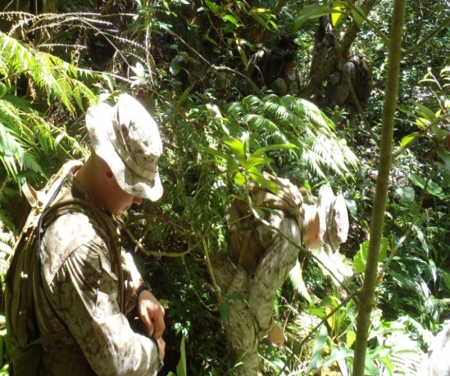
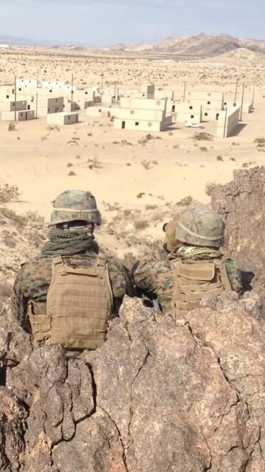
Enhanced
Observation
Tracking
(Ground Sign Awareness)
Profiling (Environment
and Behavioral Cues)
END STATE: Be able to effectively use day, night, and thermal optics to observe and survey the area of operation, IOT collect information.
The formal development of a trained tracking team effectively integrates team problem solving, critical thinking and follow-up skills to the modern military. Marines trained to identify and interpret the visual environment cues and take appropriate action.
Baseline + Anomaly = Decision
Six Domains of Profiling:
1. Biometrics
2. Kinesics
3. Proxemics
4. Iconography
5. Geographics
6. Atmospherics
1. Capabilities and Limitations of Vision
2. Bias towards seeing movement
3. Why Objects are Seen: Line, Edge, Outline, Contrast or Value, Color, Shape, Texture, Light, Movement, and Rhythm and Flow
4. Hasty / Detailed Search
5. Record Information
6. Integrated Observation Planning
General Mattis’ intent was clear, to make Marines into capable hunters in any environment, allowing them to take the initiative and actively hunt down our enemies.
Threat Behavior
Acronym
A- Alone and Nervous
Unresponsive, distant, and/or inattentive
Appearing to be in disguise
Appearing in a trance
L- Loose or Bulky Clothing
Inappropriate clothing for the season
Exposed wires
E- Excessive Fidgeting
Clock watching, and area scanning
(checking their “6”)
R- Rigid Midsection
Rigid posture with minimal body
movement, arms close to sides
T- Tightened Hands
Repeatedly patting upper body
Every Marine a Collector (EMAC)
END STATE: Marines are trained to observe and recognize human behaviors, patterns, and trends that are indicative of a threat and to act on that threat quickly and decisively through an improved, matured, decision-making process.
“Justice follows where evil has tread.”

